Slide 1
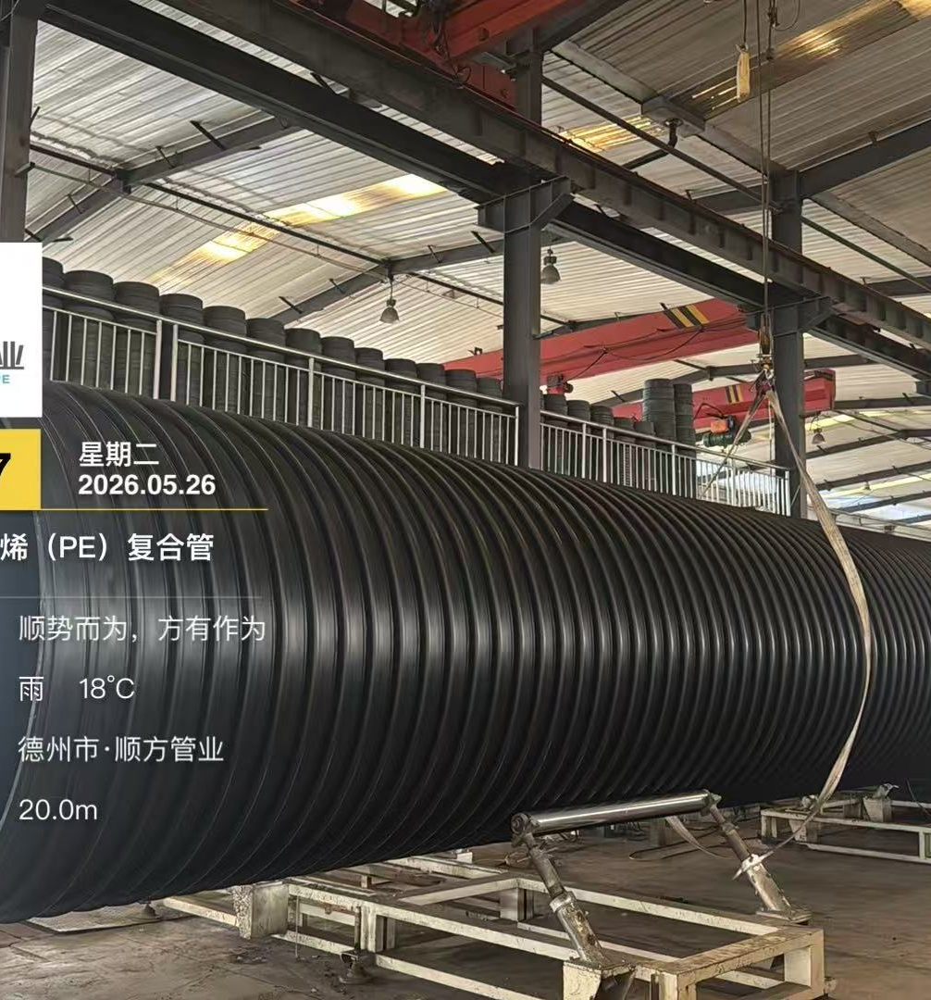
SHUNFANG INTERNATIONAL
Large Diameter Pipe
One Stop Solution
MAX Diameter 6m
HDPE Pipe / Structured Wall / Pressure Pipe

Slide 2
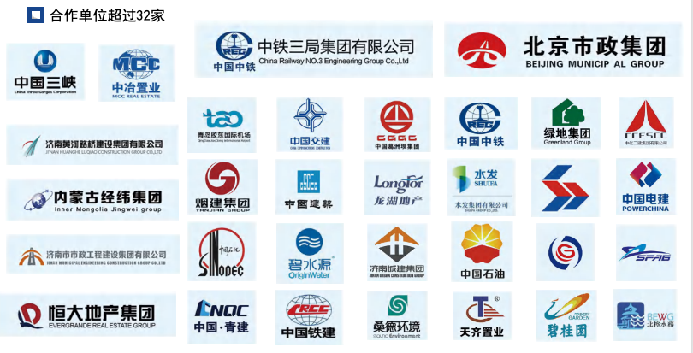
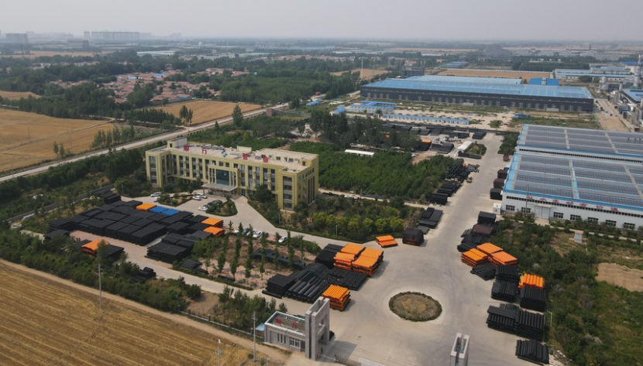
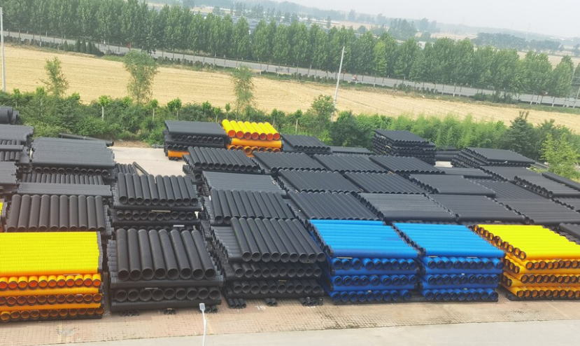
01 Who are we?
Who are we?
Standard participant:
involved in the preparation and drafting of multiple national and industry standards.
6 m super-large drainage pipe:
domestic record holder for maximum pipe diameter.
Standards / cooperation / qualification material
High-pressure water supply pipe:
record holder for large-diameter pressure pipe.
On-site production by pipe equipment:
Over Dia 3m pipe, we can mover equipment to site place.
Factory overview
Pipe yard
Shunfang Pipe Industry Co., Ltd.

Slide 3
02 About us
About us
Company facts.
24 years
10+
20+
33
Pipe industry experience
Invention patents
Utility model patents
Production lines
Shunfang Pipe Industry Co., Ltd. was established in October 2011. It is a high-tech industrial company specialized in the production of plastic pipe products.
The company has total assets of RMB 500 million and fixed assets of RMB 300 million, covering 42 Acre with a building area of 100,000 square meters.
Shunfang Pipe Industry Co., Ltd.

Slide 4
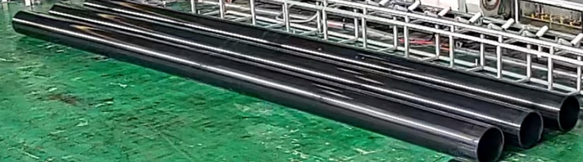
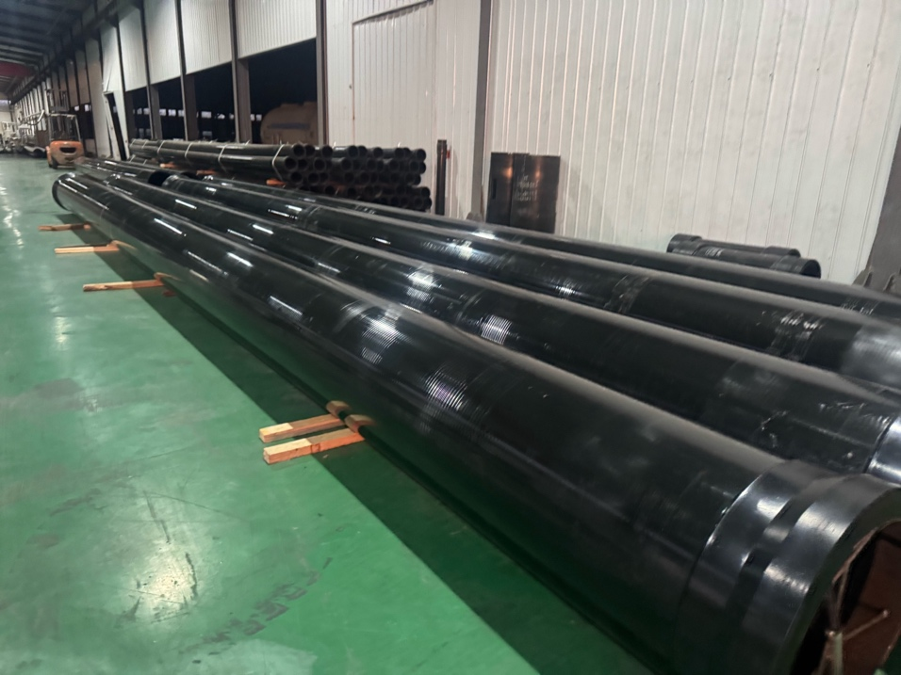
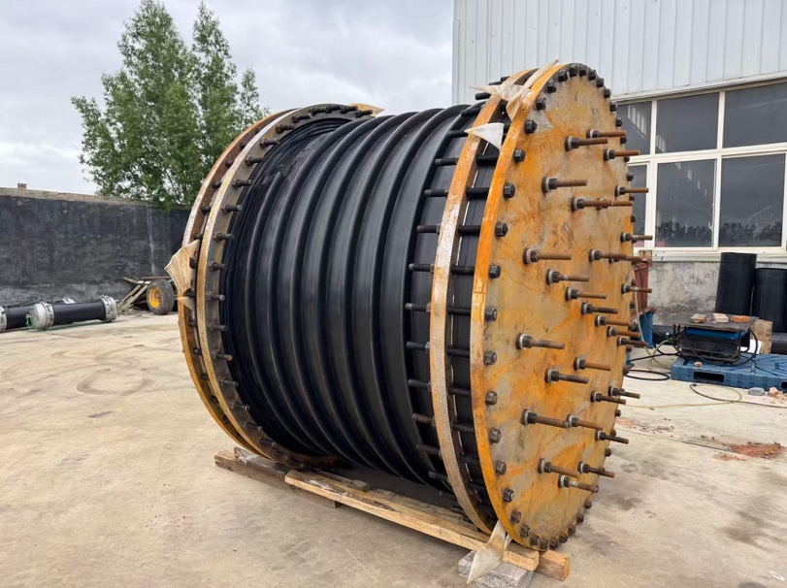
02 About us
Production lines and certifications
33 production lines, satisfy different client request.
Introduced leading domestic production lines with independent intellectual property rights.
Passed ISO9001 quality management system certification.
Passed ISO14000 environmental management system certification.
Production line
Passed OHSAS18000 occupational health and safety management system certification.
Pressure pipe products
Large diameter winding / production
Shunfang Pipe Industry Co., Ltd.

Slide 5
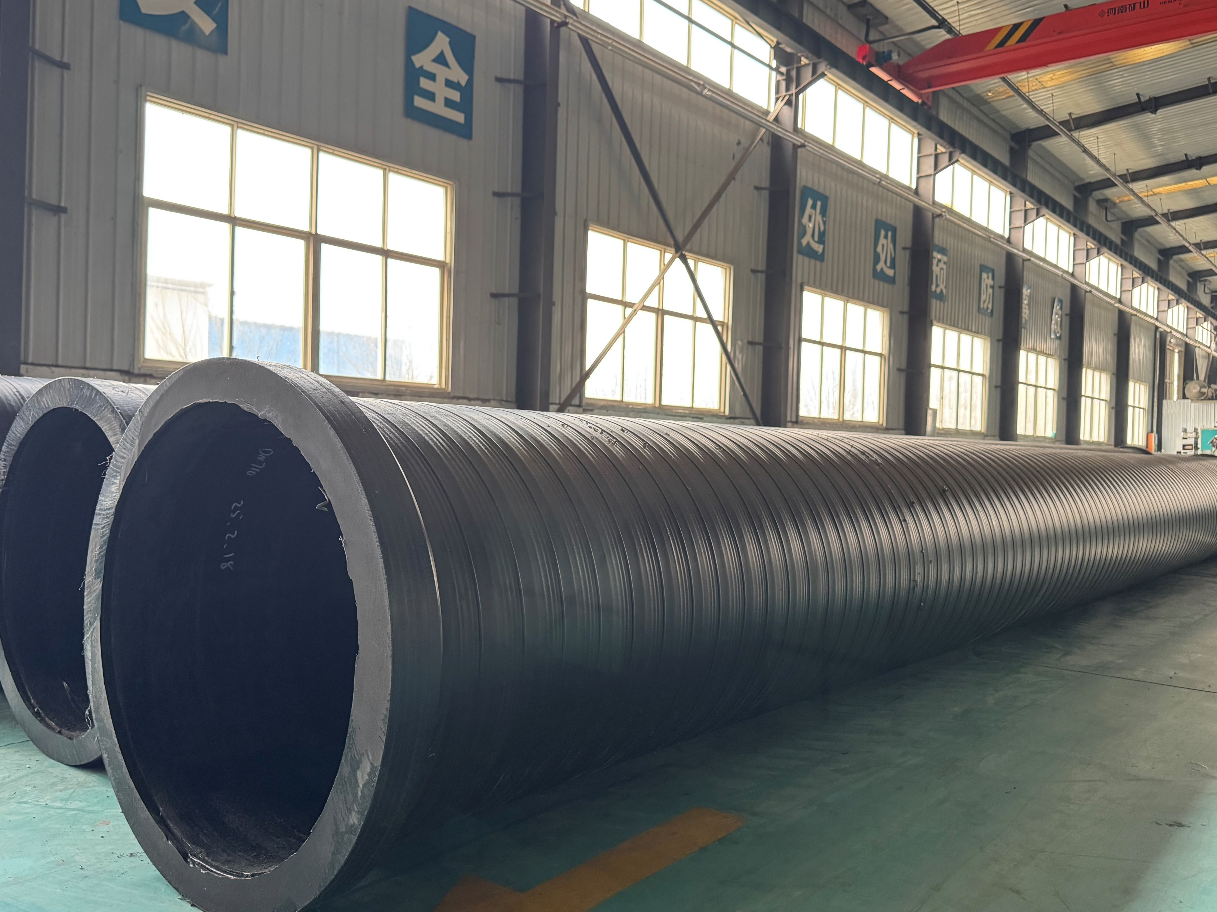
03 Our products
Our products
1
Potable Water Pipe / Pressure Pipe
High-pressure water supply pipe
Large Diameter Potable Water Pipe
2
Drain / Storm Drain / Sewer / Sea Outfalls Pipe
Structured wall HDPE pipe
Reinforced PE pipe
3
Other Products
Septic tank / septic tank / permeable module

Slide 6
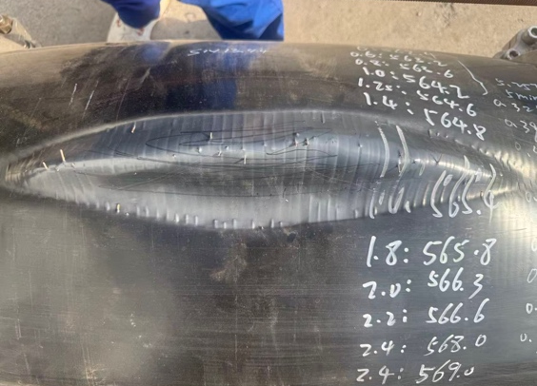
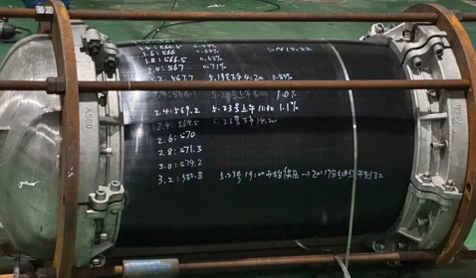
1 Potable Water Pipe / Pressure Pipe
High-pressure water supply pipe
DN560 pressure test reference
Design pressure: 1.6 MPa
Pressure holding: 2.4 MPa for 118 h
Maximum pressure: 3.4 MPa
Shunfang Pipe Industry Co., Ltd.

Slide 7
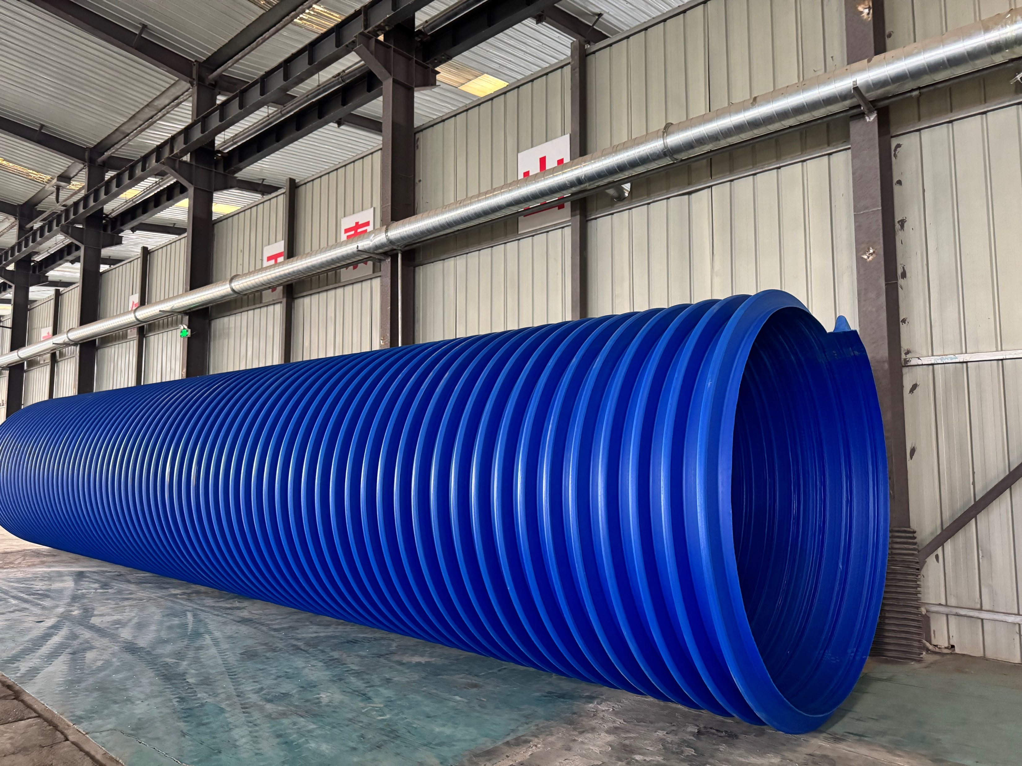
1.2 Large Diameter Potable Water Pipe
Large Diameter Potable Water Pipe
Production line
Large-diameter pipe production
Pipe storage
Large pipe body
Shunfang Pipe Industry Co., Ltd. |

Slide 8
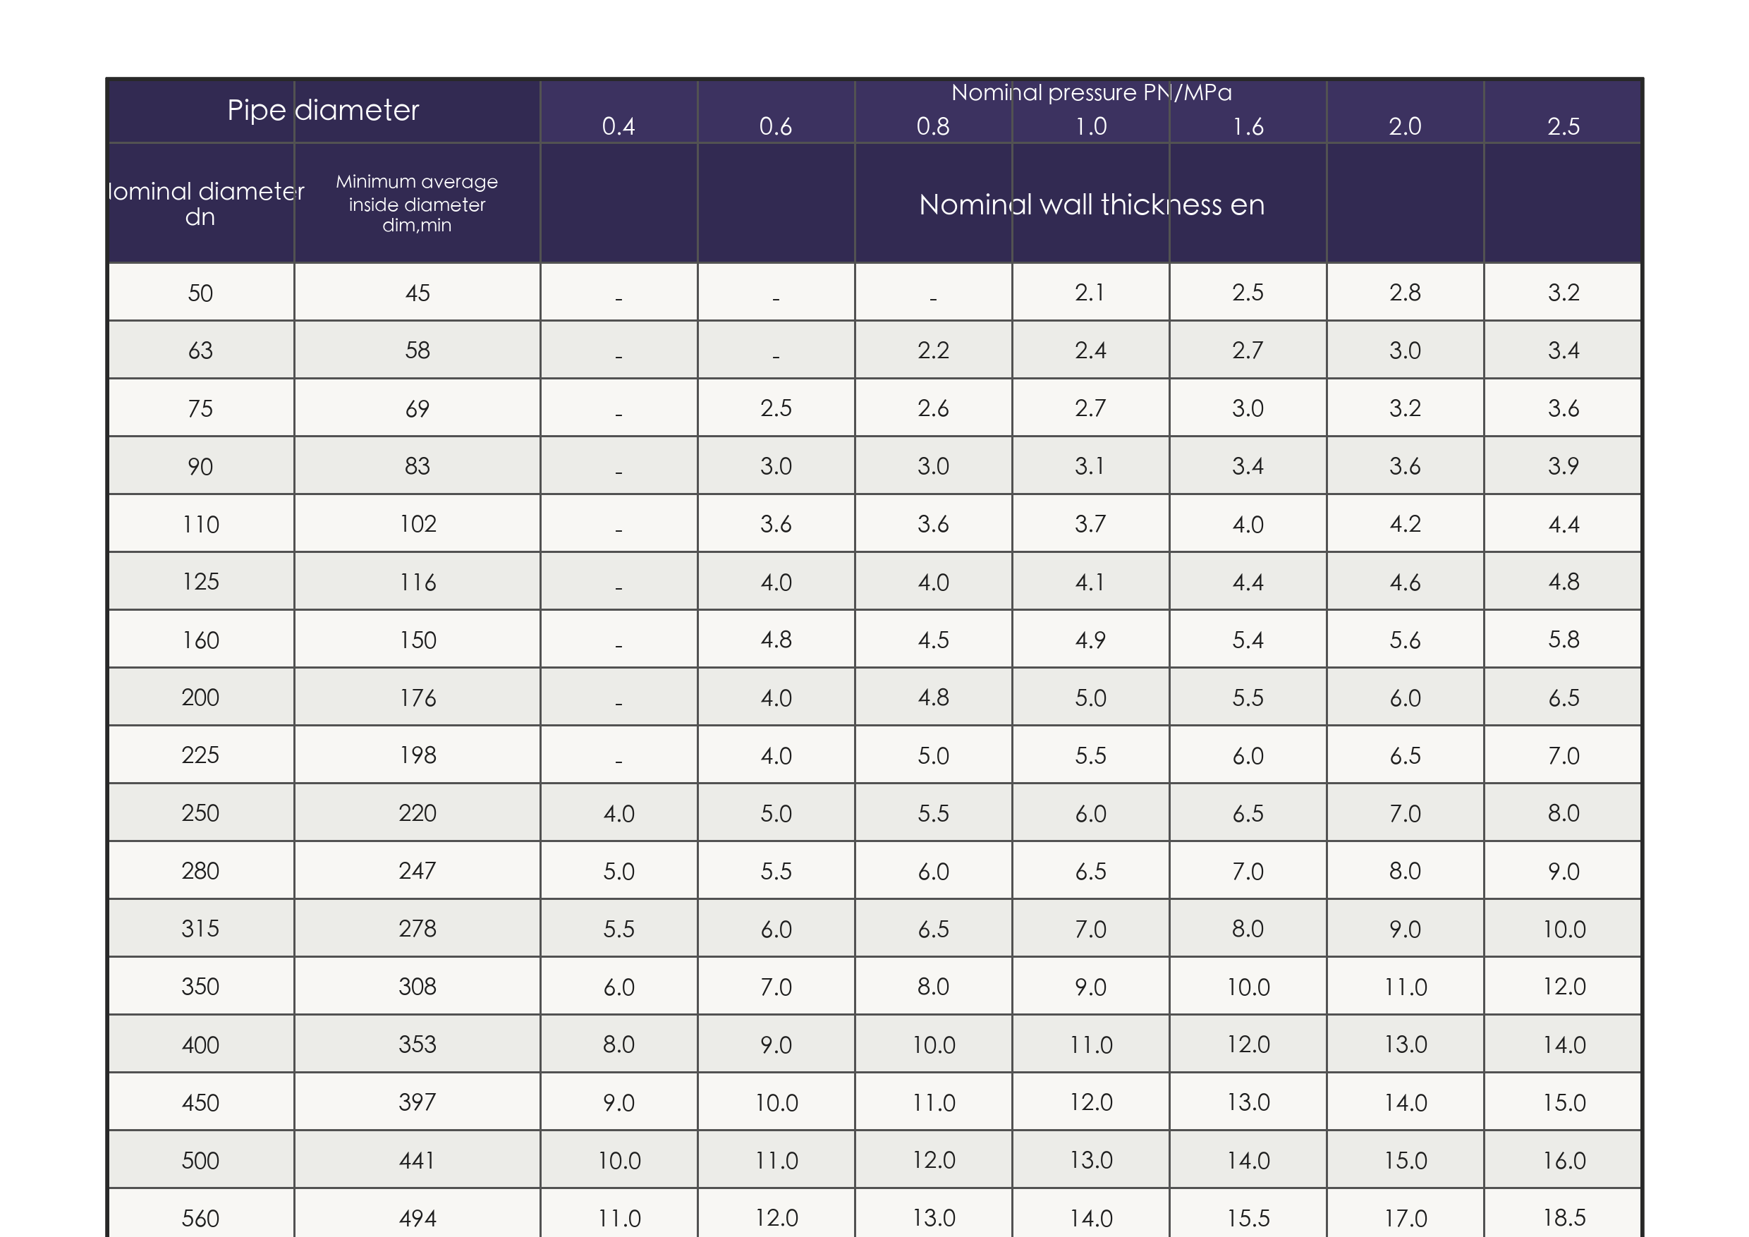
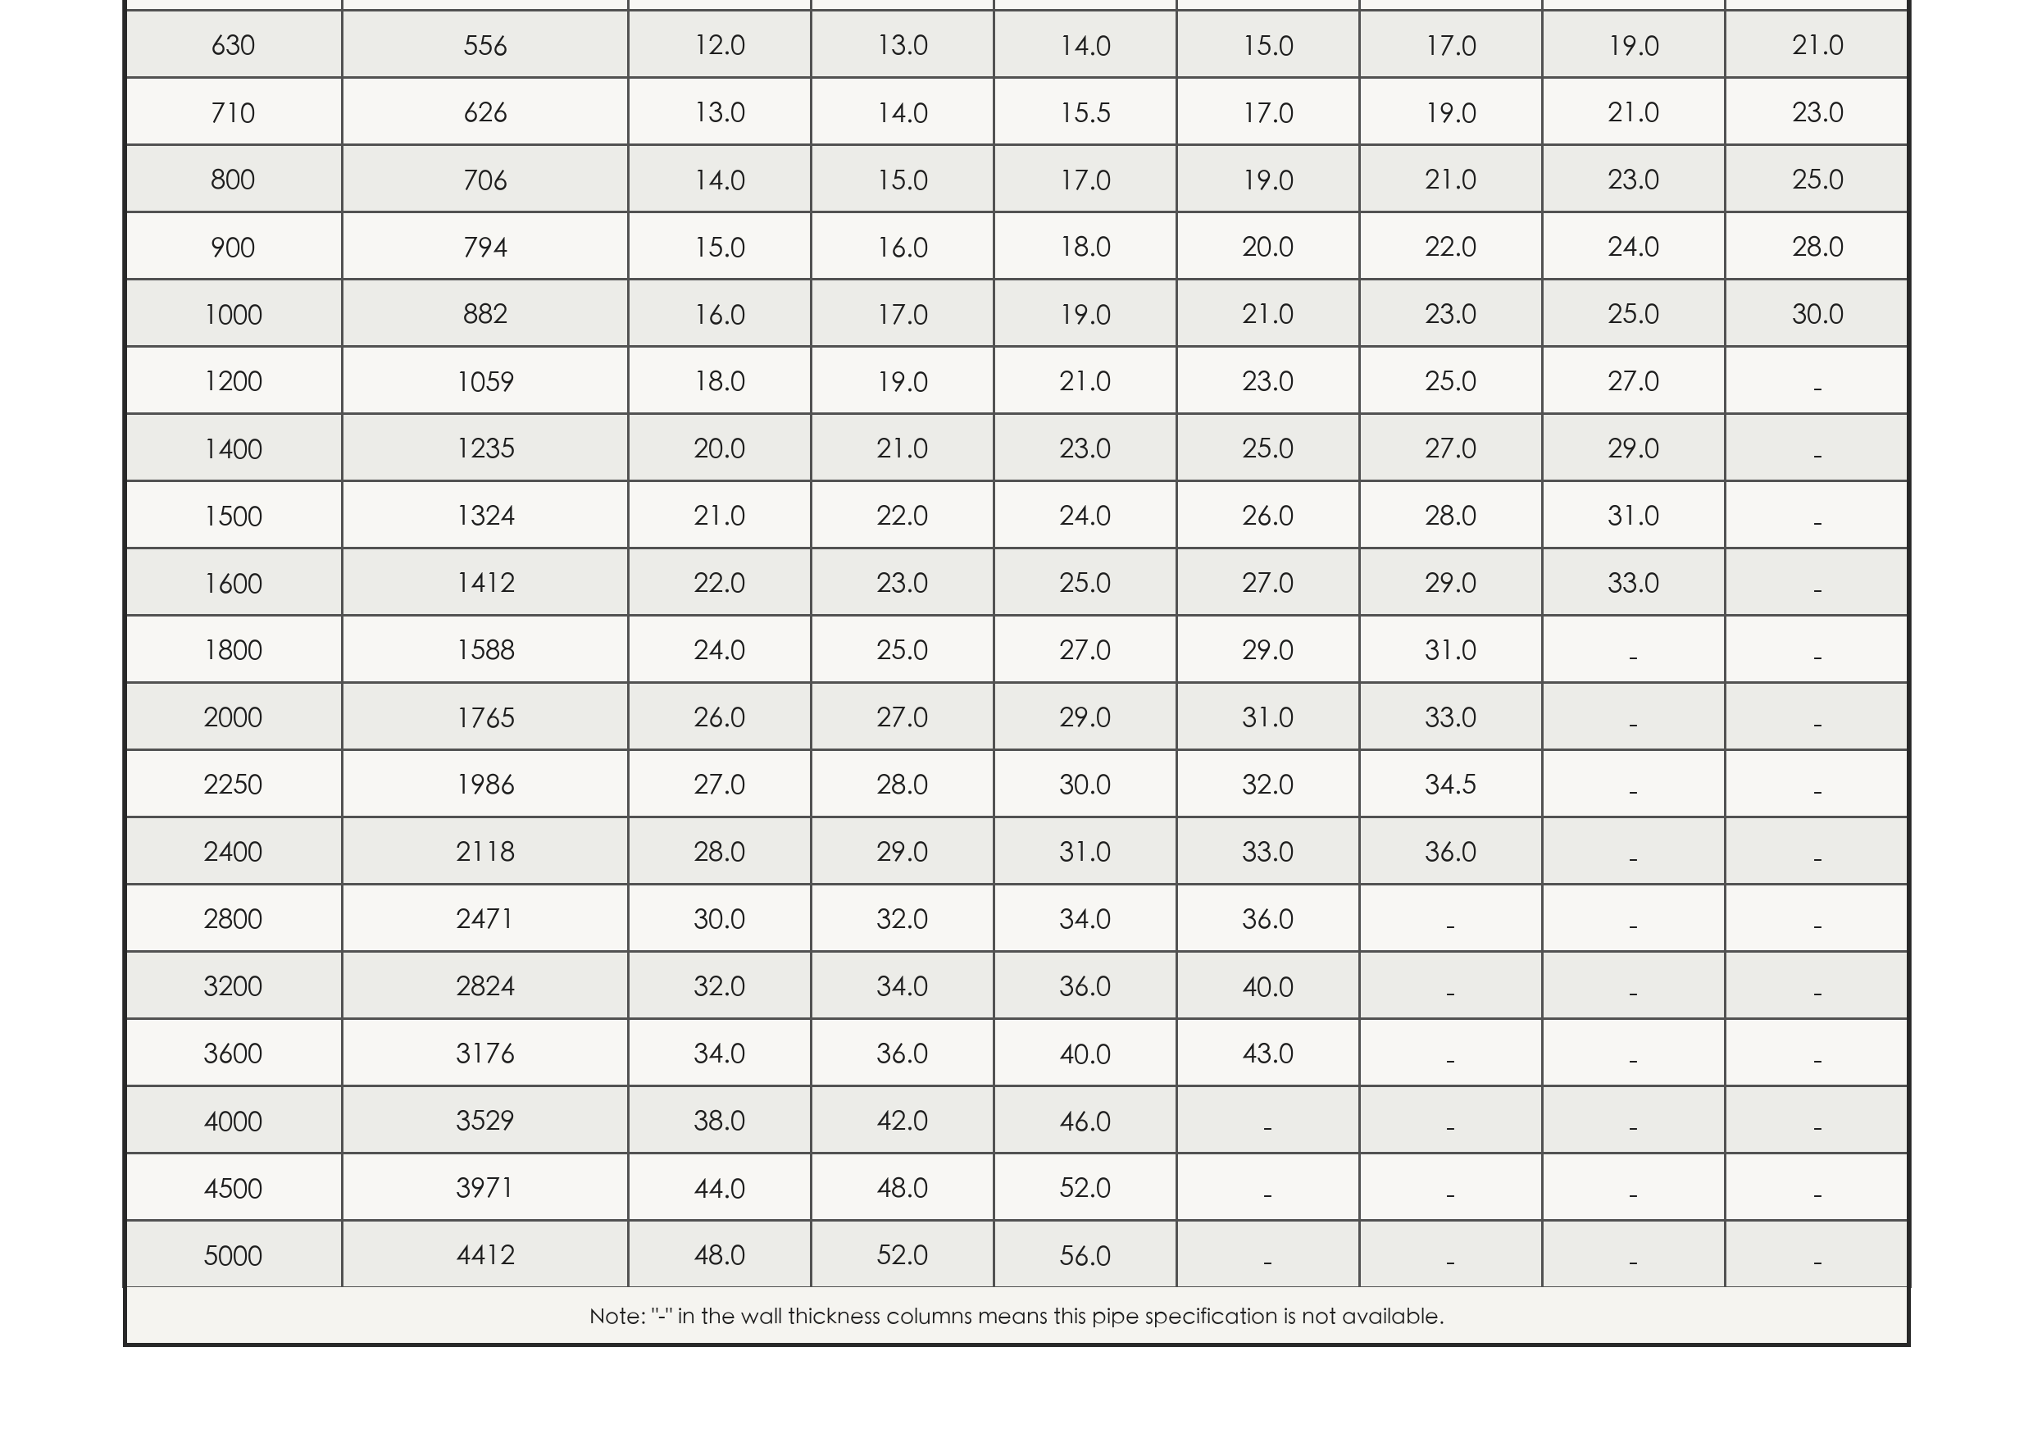
1.2 Technical Specification Table
Technical Specification Table
Original specification table from the provided document, enlarged into two readable sections.
Upper section
Lower section
Shunfang Pipe Industry Co., Ltd.

Slide 9
2 Drain / Storm Drain / Sewer / Sea Outfalls Pipe
Large-diameter structured wall pipe Reinforced PE pipe
Drain
Storm drain
Sewer
Sea outfalls pipe

Slide 10
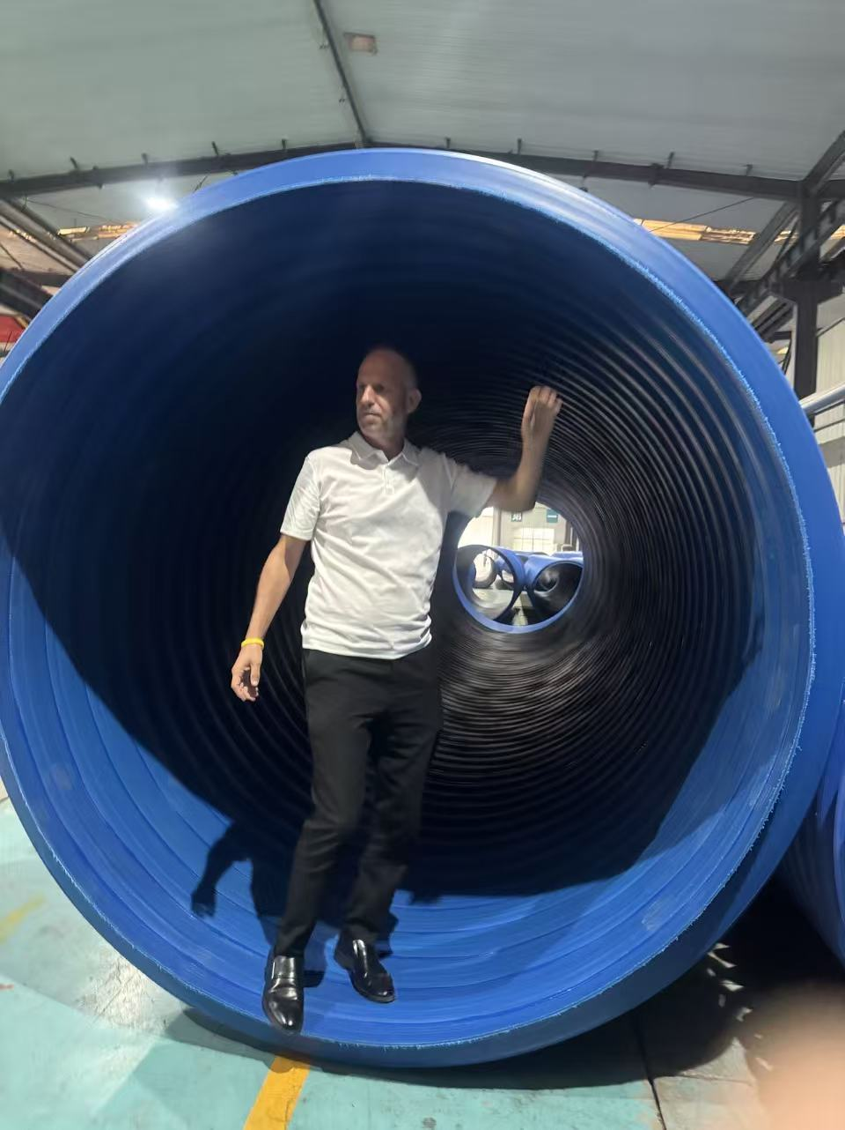
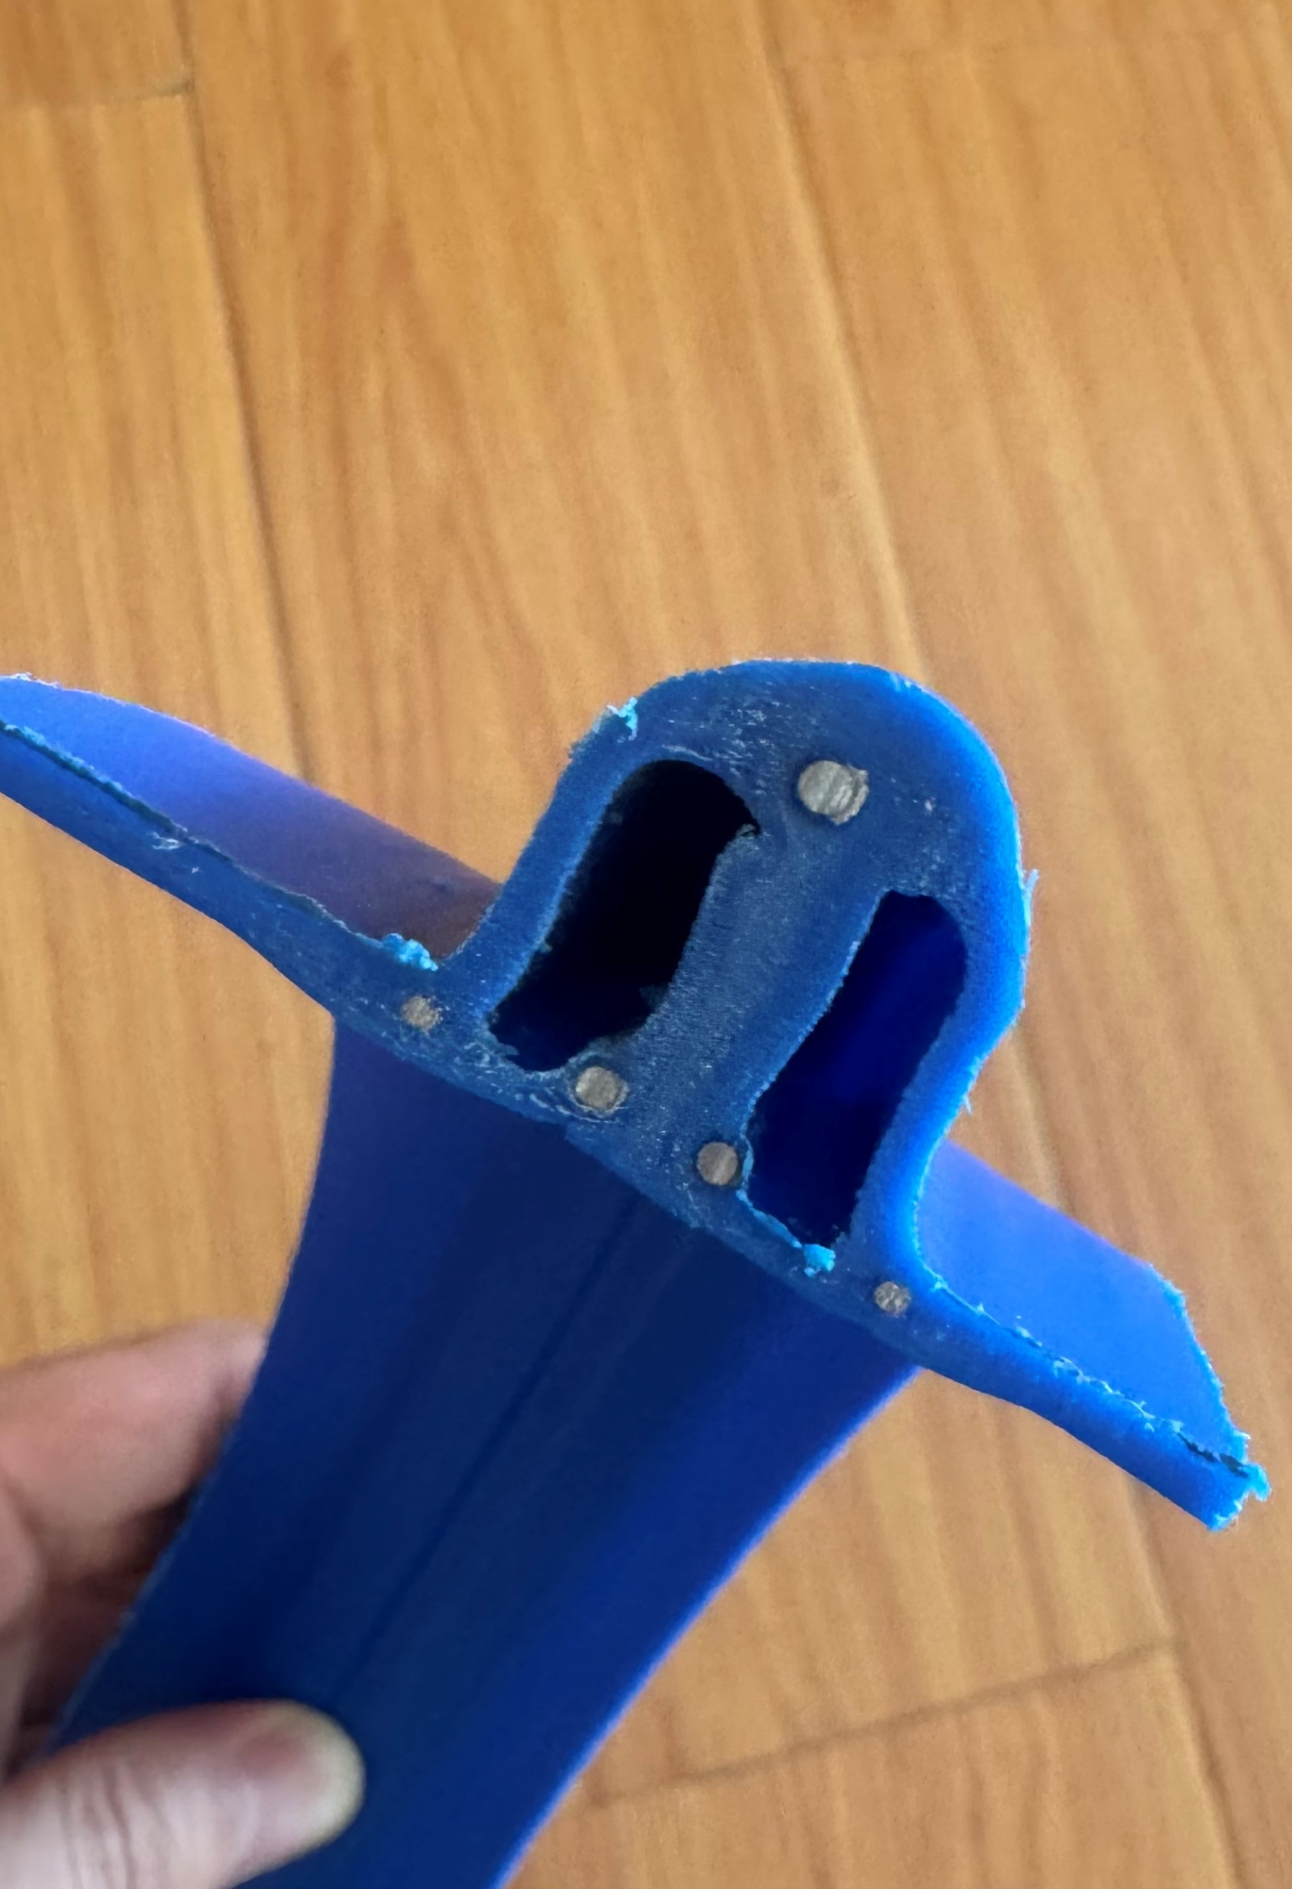
2.1 Characters
Characters
PE80 / PE100 material with high flexibility, excellent corrosion resistance and fatigue resistance.
The pipe diameter is unrestricted, with a maximum production diameter up to 6 meters and superior structural integrity.
High ring stiffness and strong bending resistance.
Resistant to acids, alkalis, salts and various organic solvents.
Scale reference
Profile / structure detail
Shunfang Pipe Industry Co., Ltd

Slide 11
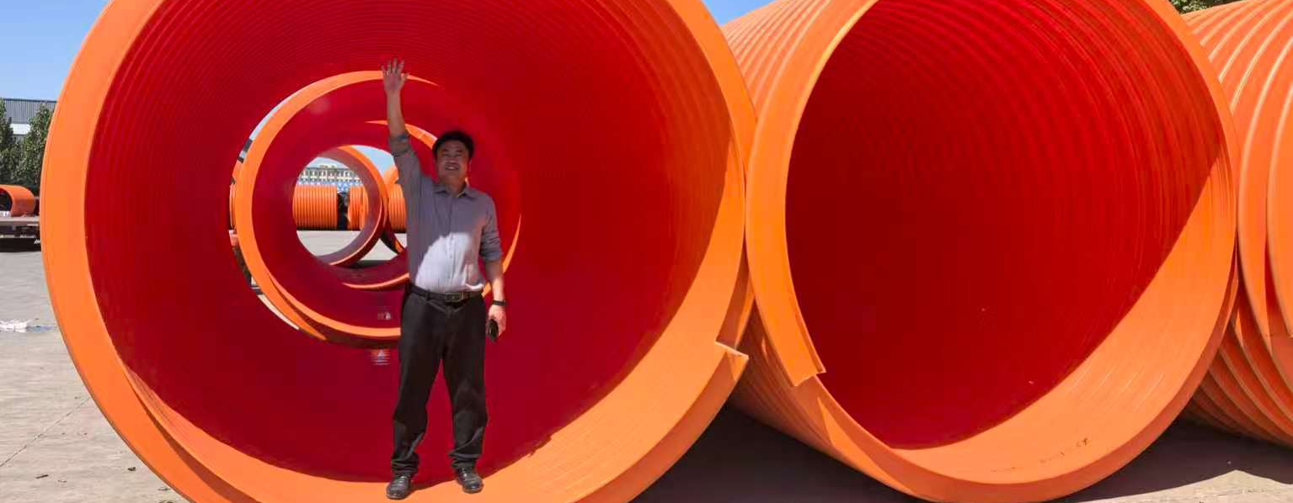
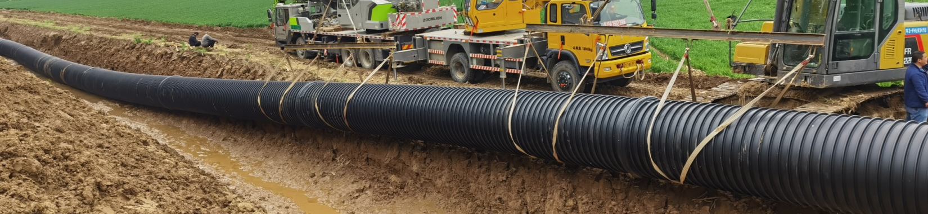
2 Drain / Storm Drain / Sewer / Sea Outfalls Pipe
Large-diameter product and installation visuals
Images are from the provided document.
On-site installation
Shunfang Pipe Industry Co., Ltd.

Slide 12
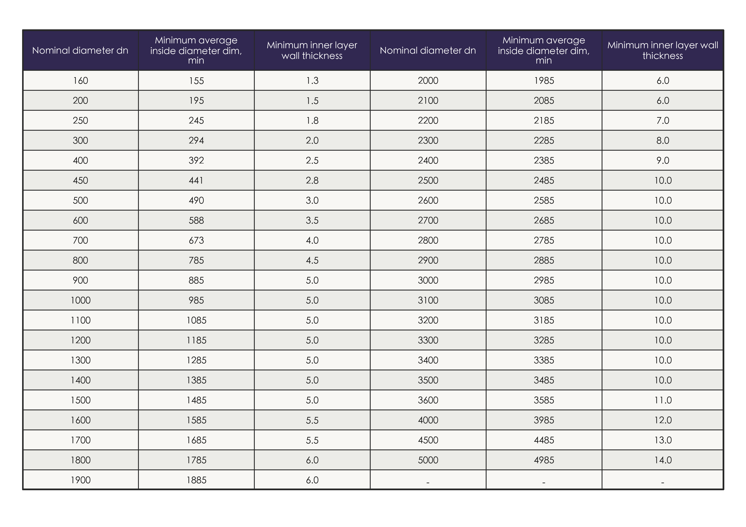
2.1 Technical Specification Table
Technical Specification Table
PS: Max Diameter 6 m.
Shunfang Pipe Industry Co., Ltd.

Slide 13
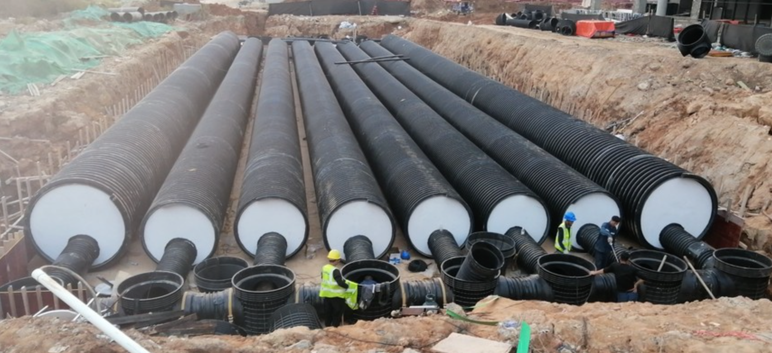
City Construction

Slide 14

2.3 The advantages at a glance
The advantages at a glance
Shunfang Pipe Industry Co., Ltd.

Slide 15
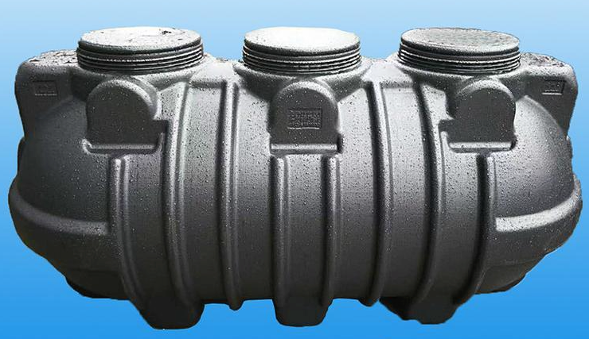
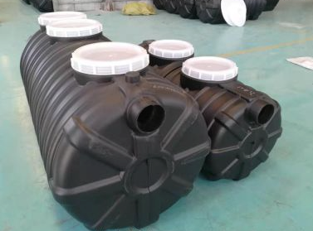
3 Other Products
Integrated Septic Tank
0.5 / 0.6 / 1.0 / 1.2 / 1.5 / 2.0 cubic meters.
Integrated septic tank
Septic tank product
Shunfang Pipe Industry Co., Ltd.

Slide 16
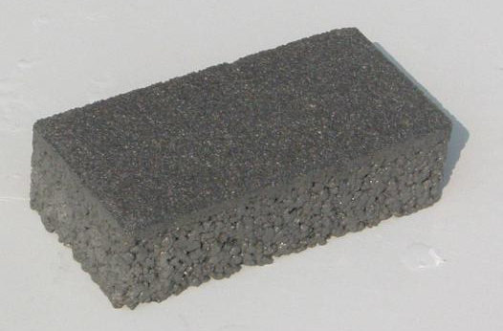
3 Other Products
Permeable Brick
Permeable brick
Shunfang Pipe Industry Co., Ltd.

Slide 17
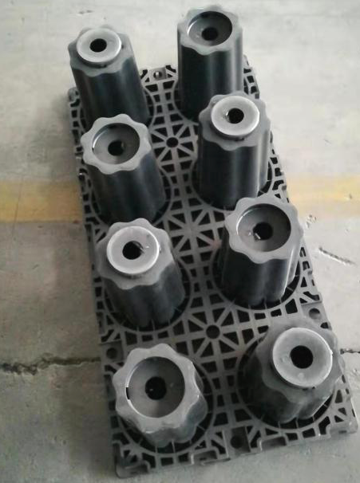
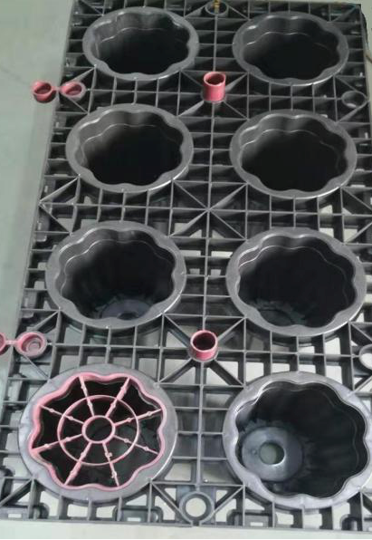
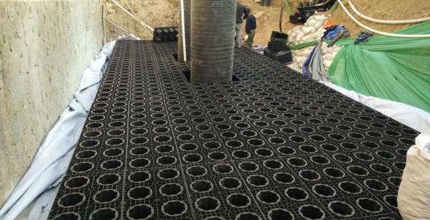
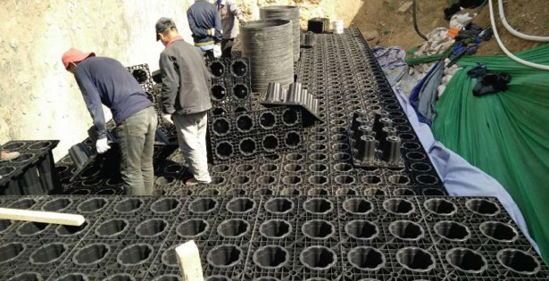
3 Other Products
Rainwater Collection Module
Installation reference
Installation reference
Module product
Module set
Related molded product visual
Shunfang Pipe Industry Co., Ltd.

Slide 18

THANKS
Looking forward to win-win cooperation with you！
Shunfang Pipe Industry Co., Ltd.

