Slide 1
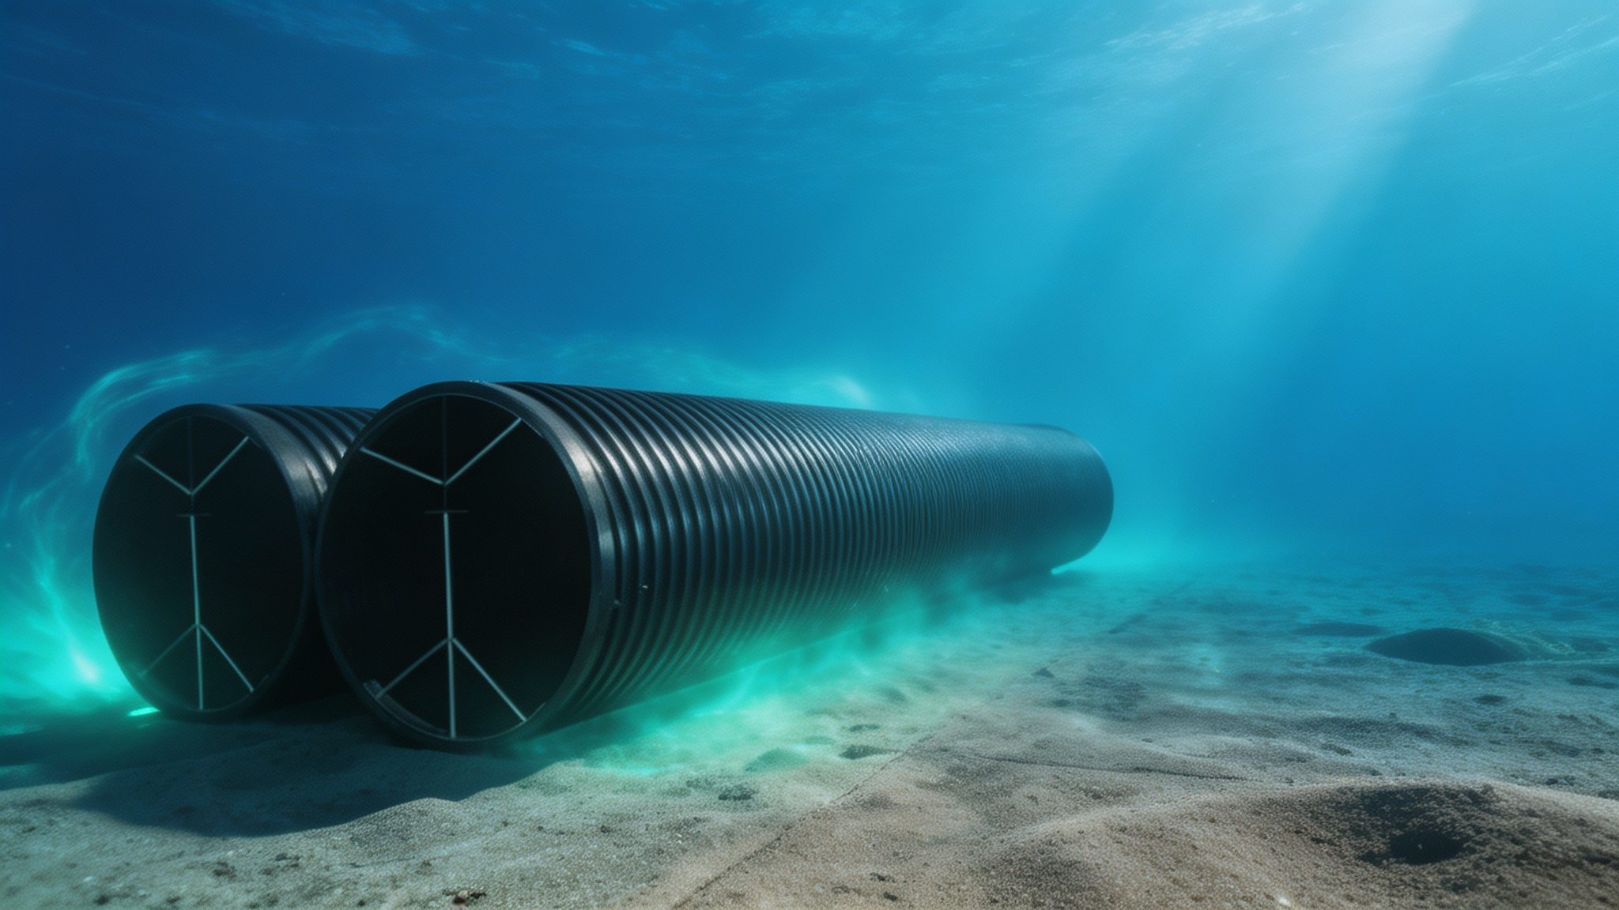
Indonesia DN2400 Pipeline Water Intake Project
Pipe Material Selection & Comparison
Date: July 2026
Notes:
大家好，今天非常荣幸能在这里向各位专家和领导汇报我们为印尼大型取水项目精心准备的加筋PE管应用方案。这个项目面临着复杂的海洋环境和严苛的技术挑战，选择合适的管材至关重要。接下来，我们将详细阐述为何加筋PE管是本项目的最佳选择。

Slide 2
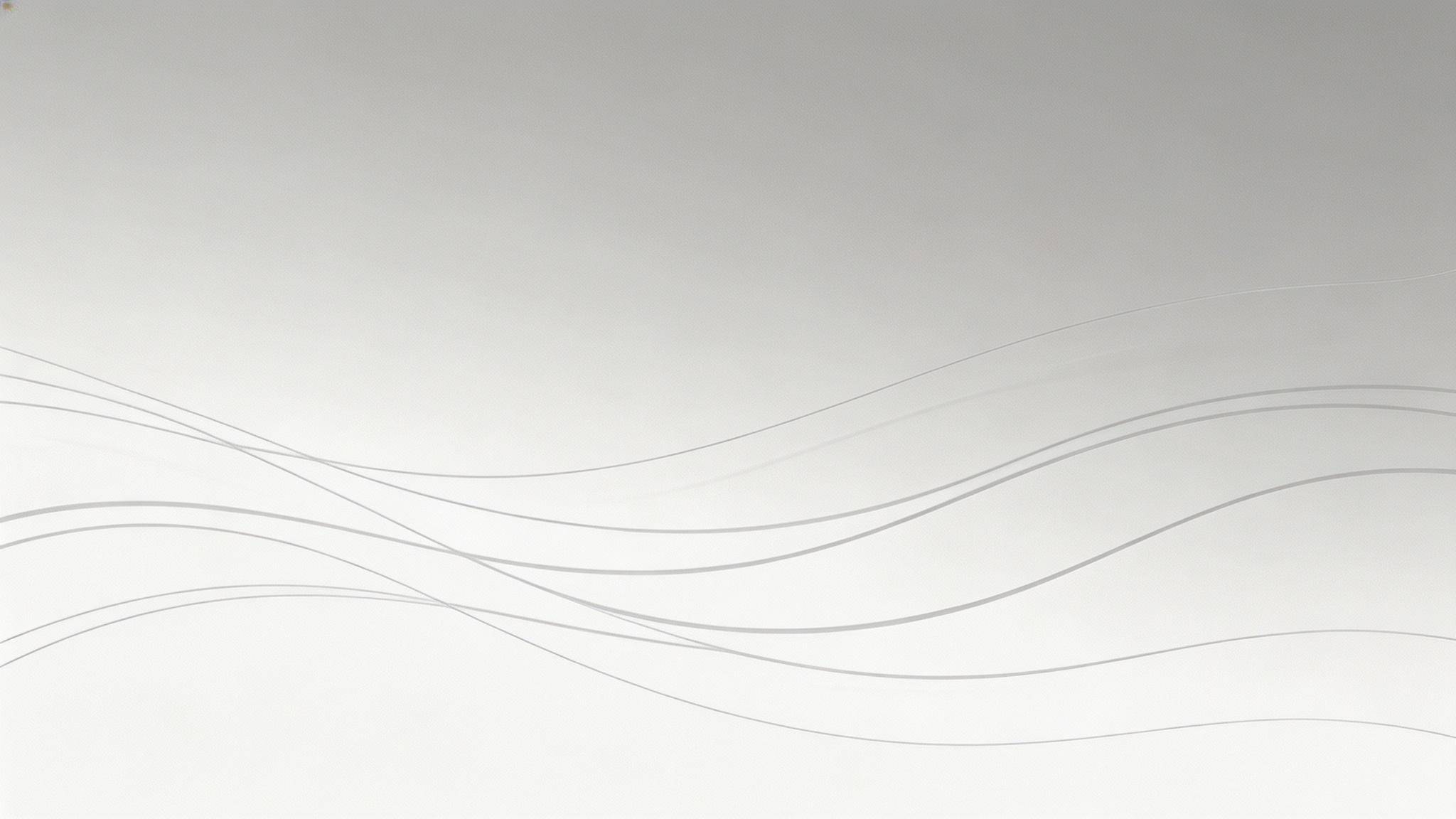
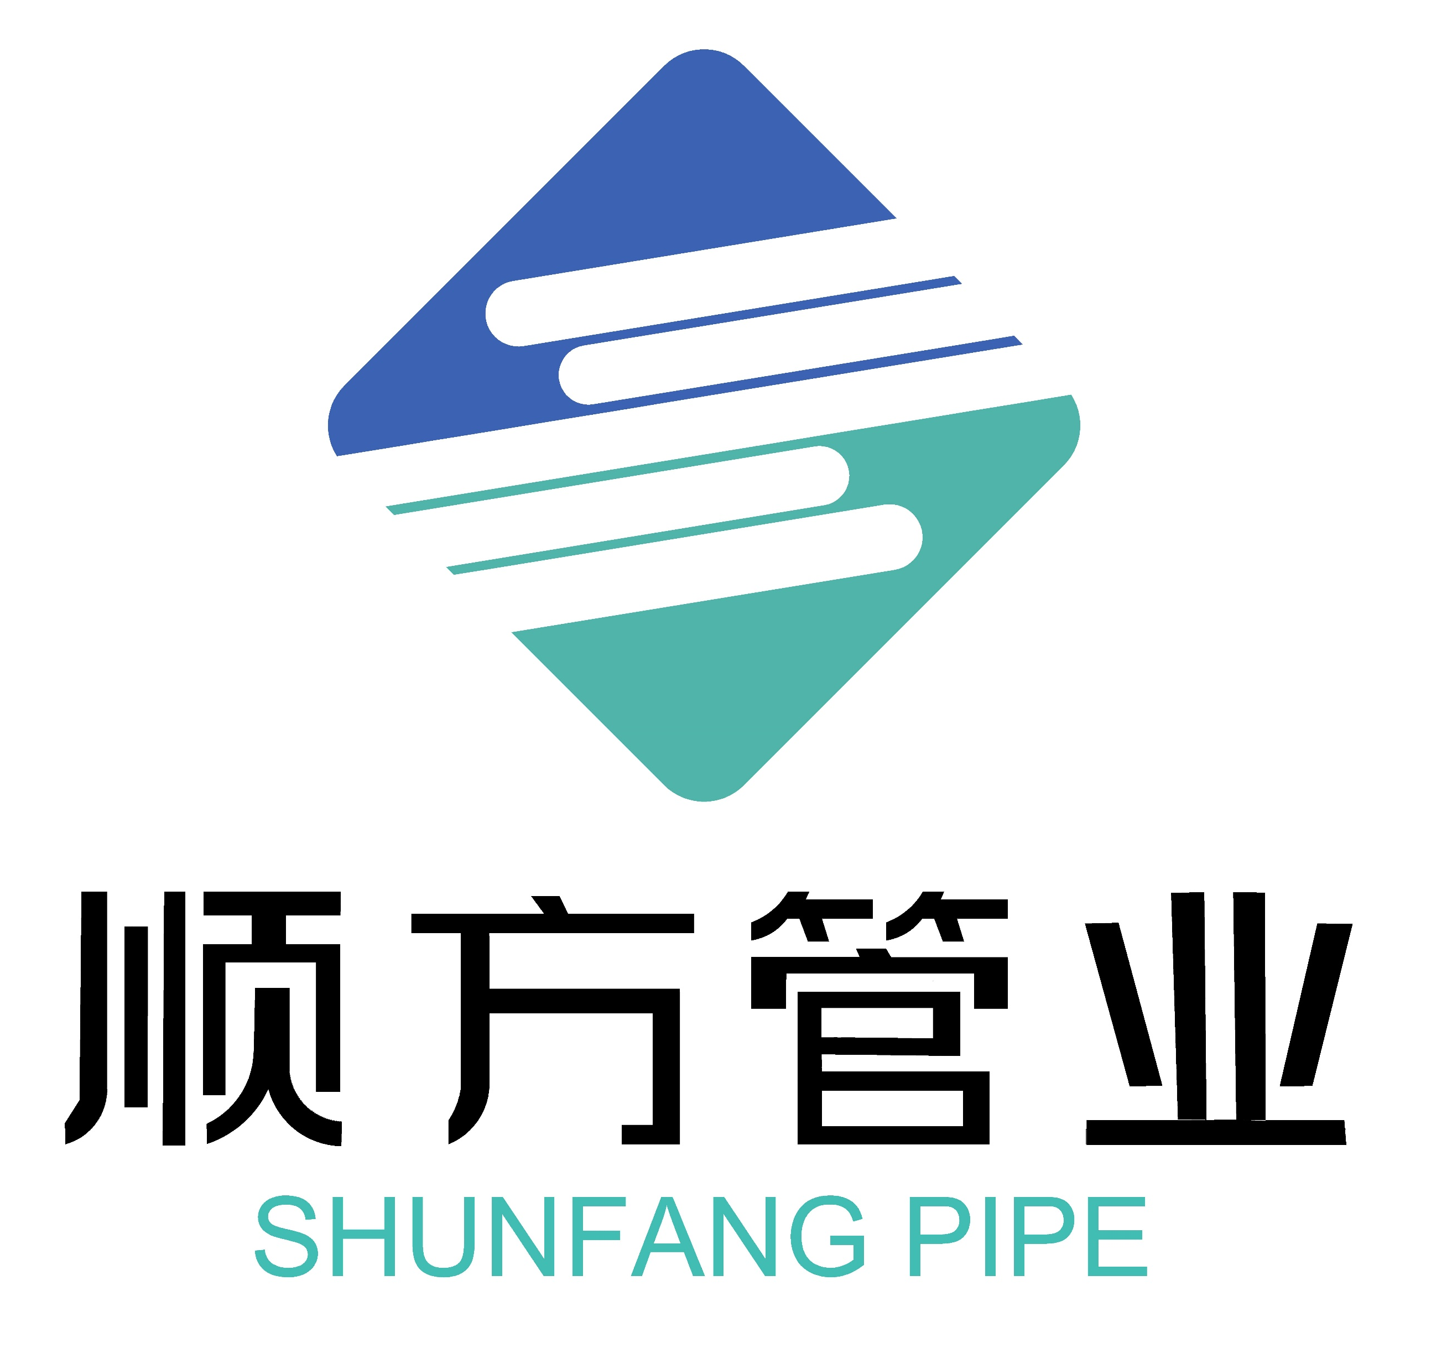
Table of Contents
01.
Project Background
04.
Reinforced PE Pipe Connection to Intake Head
02.
Reinforced PE Pipe Overview
– Connection Methods
– Material Selection
– Pipe Characteristics
05.
Reinforced PE Pipe Installation (Submerged Pipe Method)
06.
Maintenance —Biofouling and Its Impact on Flow Capacity in Seawater Service
07.
Repair
– Reinforced PE Pipe vs. PCCP Comparison
– Split-Repair Clamp: Principle & Structure
03.
Reinforced PE Pipe vs. PCCP — Installation Comparison
Notes:
我们先看海床上铺设的场景。加筋PE管的优势非常明显。它可以在岸上先焊接成几百米长的管段，然后像拖航一样整体运到海上，再慢慢沉放下去。这种方法极大地减少了海上作业时间，非常适合在养殖区施工。而PCCP管又重又刚，只能一节一节地用大吊车在海上对接，不仅效率低，而且在风浪大的时候非常危险。

Slide 3
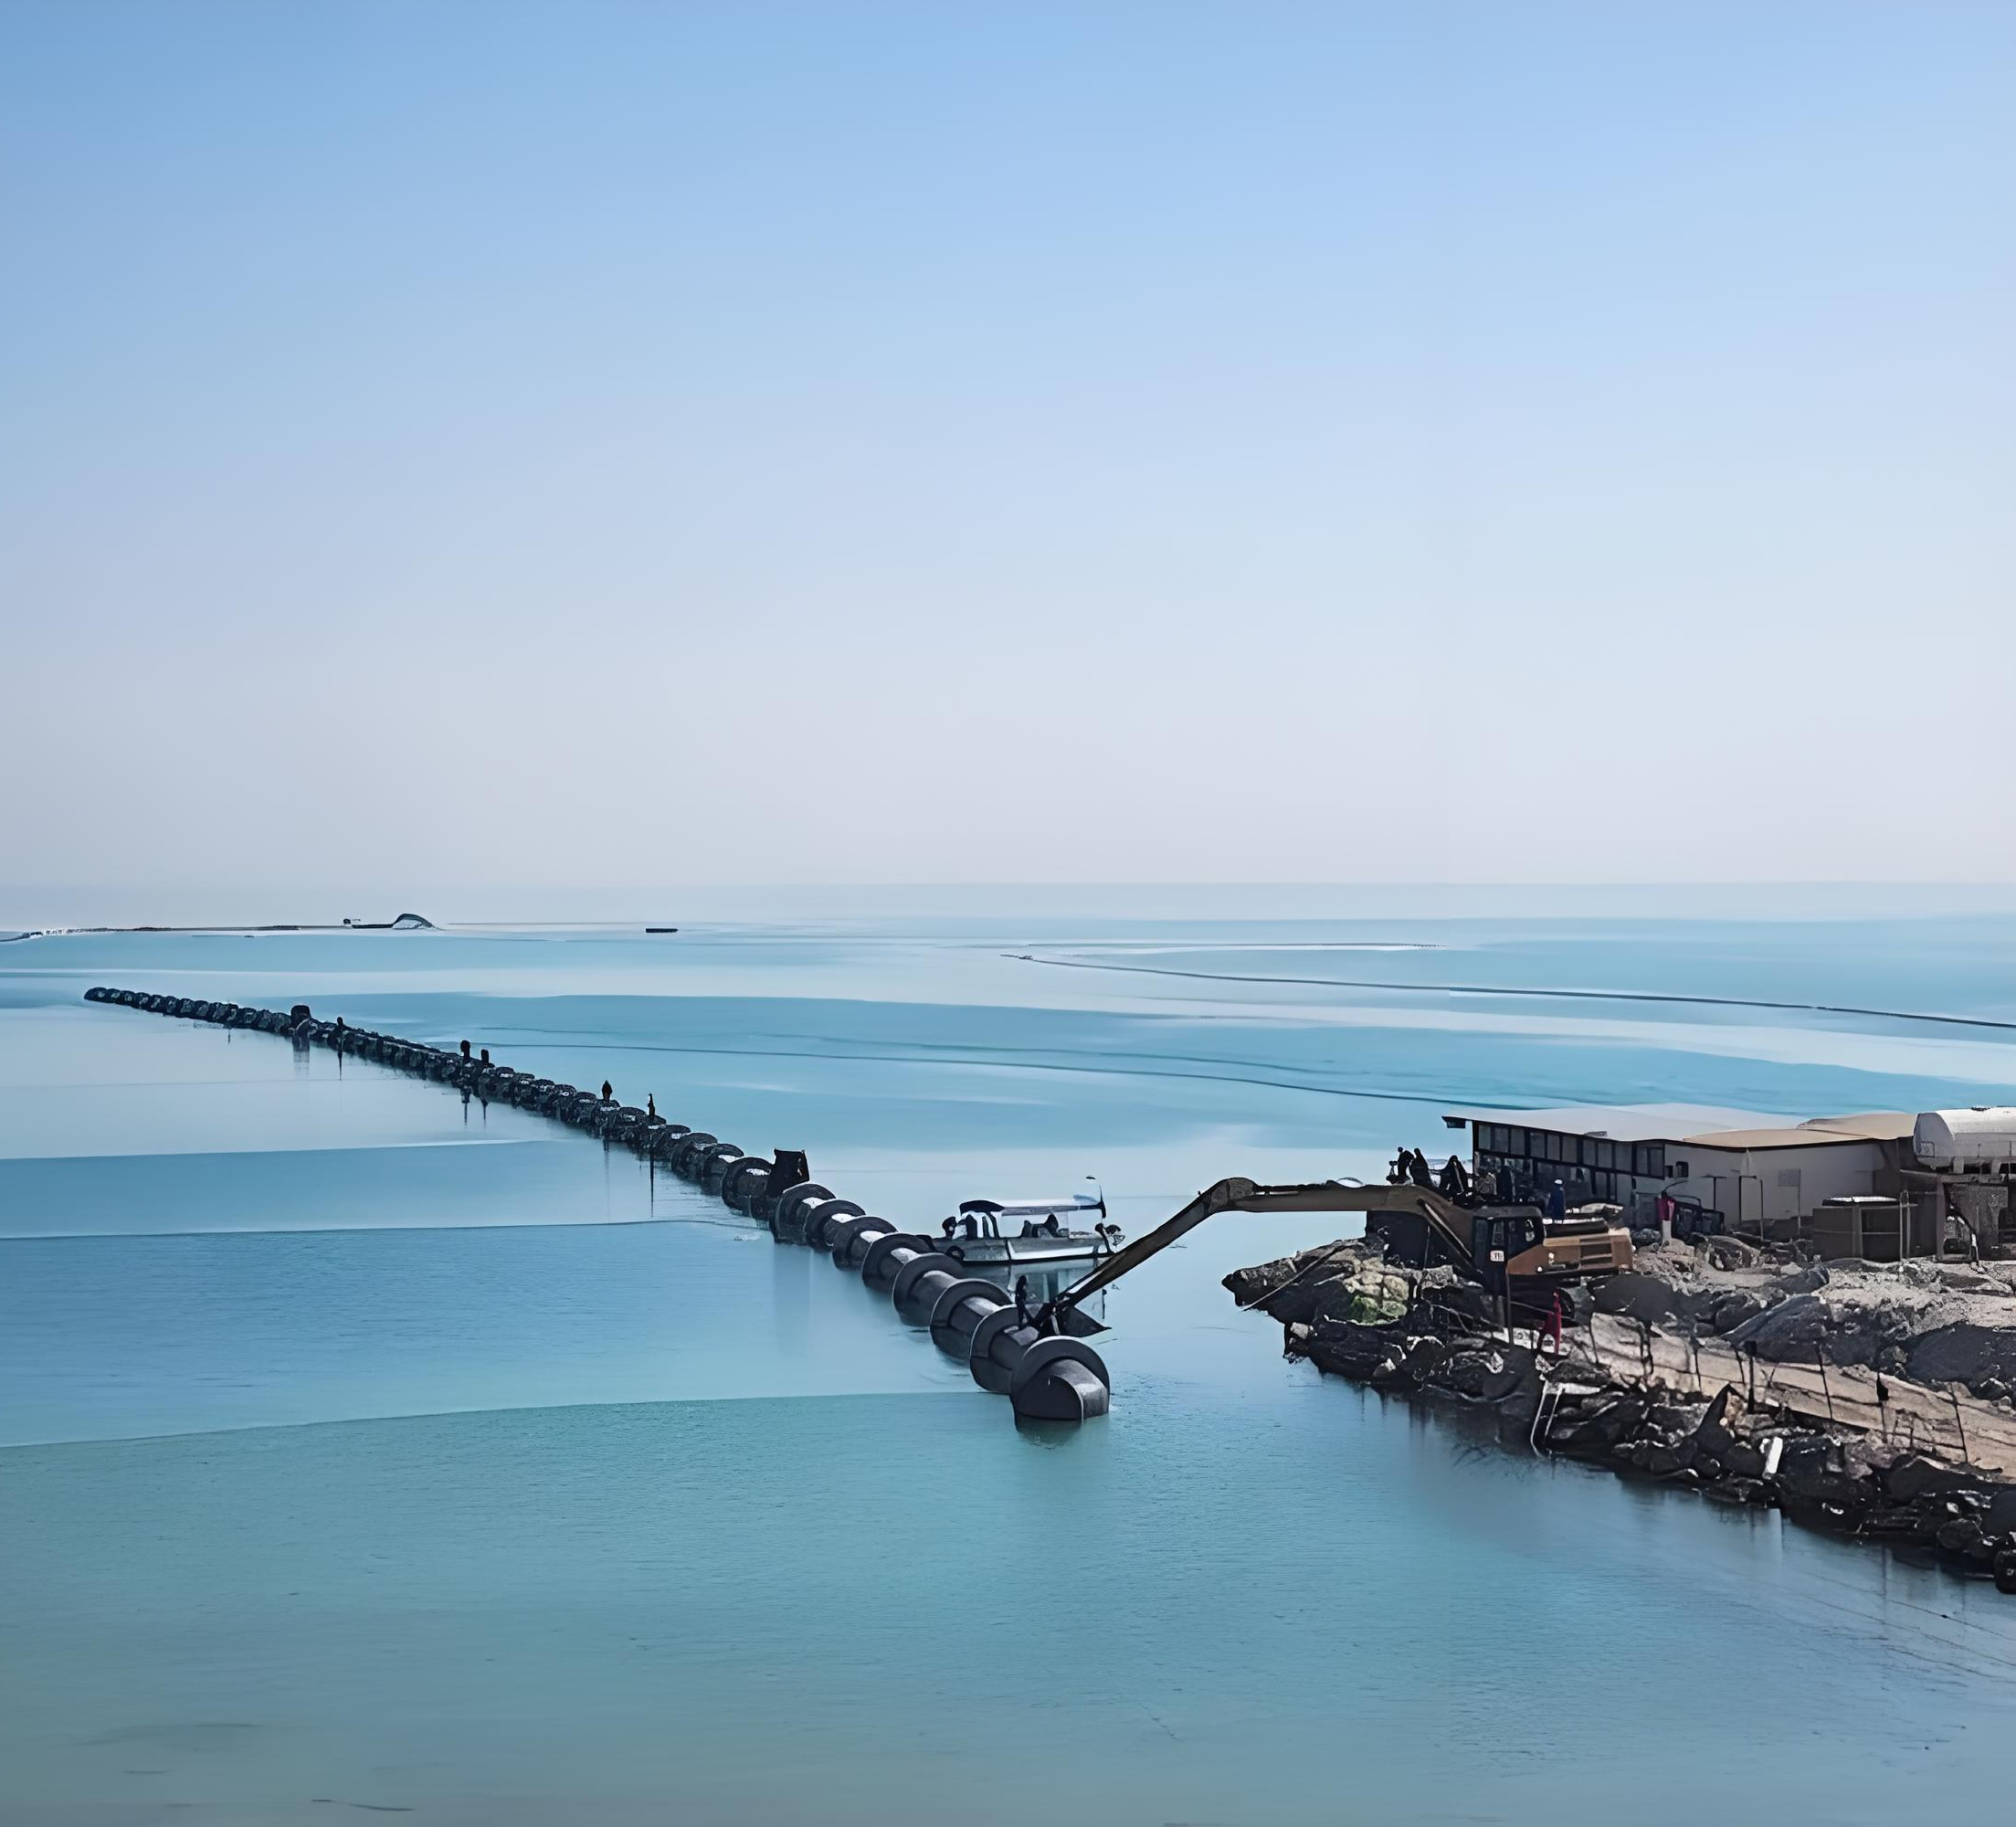


01 Project Background
Operating Conditions
Dense aquaculture zone with strong wind/wave exposure and a silty seabed; seawater is high-salinity, highly corrosive, with heavy marine biofouling.
Pipe Specifications
Nominal diameter DN2400 (2.4 m), rated pressure 1.0 MPa. Each pipe run is 600 m, laid as twin parallel lines.
Notes:
首先我们来看项目概况。这是一个位于印尼沿海的大型海水取水工程，旨在为沿岸的重要工业设施提供冷却用水。工程规模宏大，需要建设两条平行的、直径达2.4米的海底管线。如此巨大的管径和复杂的应用场景，对管材的选择提出了极高的要求。

Slide 4
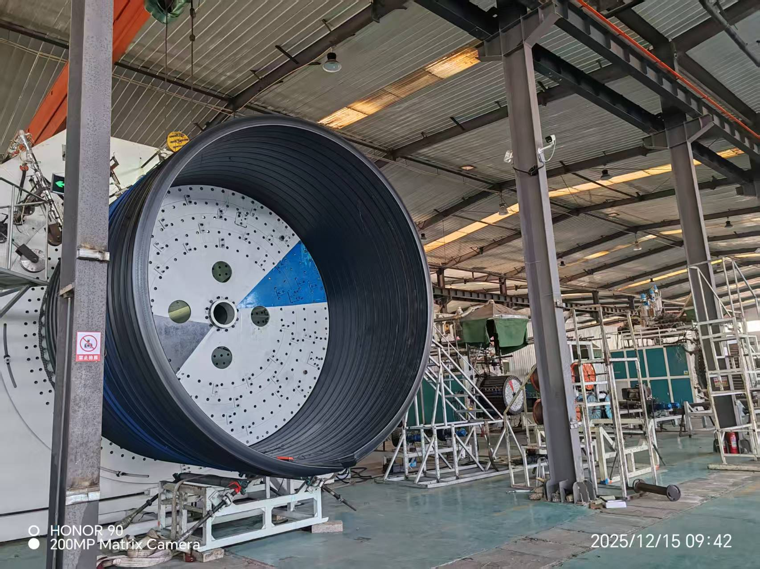
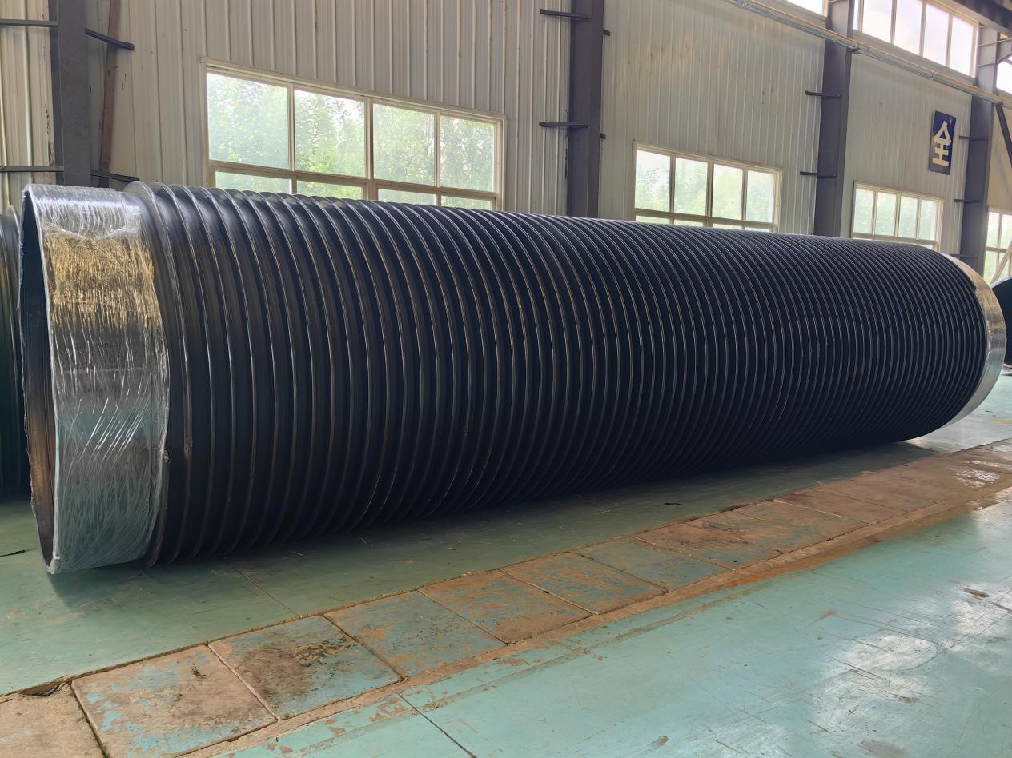
02 Reinforced PE Pipe Overview
Reinforced PE Pipe
Reinforced polyethylene (PE) composite pipe is formed by spirally winding high-strength carbon spring steel wire between layers of high-molecular-weight PE sheet, then heat- and pressure-bonding them into one composite wall. Proven over years of R&D and field deployment, it delivers exceptional ring stiffness and sealing performance, plus PE's inherent flexibility, impact resistance, settlement tolerance, chemical resistance, and abrasion resistance — with a service life of 50+ years. Highly cost-effective, available up to DN4000.
Notes:
我们先看海床上铺设的场景。加筋PE管的优势非常明显。它可以在岸上先焊接成几百米长的管段，然后像拖航一样整体运到海上，再慢慢沉放下去。这种方法极大地减少了海上作业时间，非常适合在养殖区施工。而PCCP管又重又刚，只能一节一节地用大吊车在海上对接，不仅效率低，而且在风浪大的时候非常危险。

Slide 5
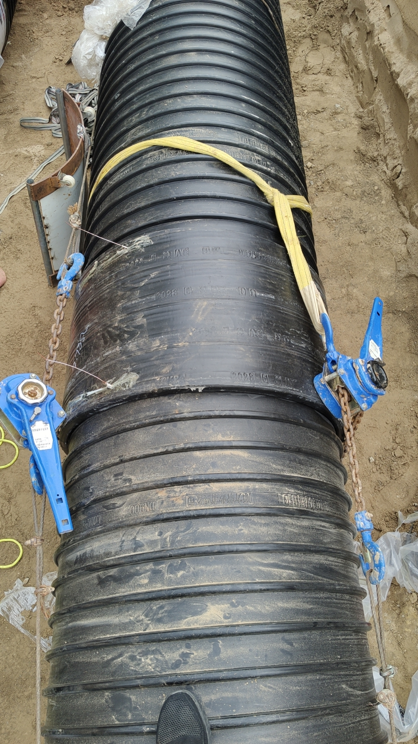
02 Reinforced PE Pipe Overview
I. Pipe Connection Methods
Reinforced PE composite pipe is joined using electrofusion coupling or butt-fusion welding.
01
Electrofusion Coupling
Pipe ends are machined into smooth spigots and inserted into our proprietary electrofusion couplings. A dedicated electrofusion welder energizes embedded resistance wire inside the coupling, melting the joint interface for a fully sealed, leak-free connection.
Coupling Installation Diagram
Notes:
我们先看海床上铺设的场景。加筋PE管的优势非常明显。它可以在岸上先焊接成几百米长的管段，然后像拖航一样整体运到海上，再慢慢沉放下去。这种方法极大地减少了海上作业时间，非常适合在养殖区施工。而PCCP管又重又刚，只能一节一节地用大吊车在海上对接，不仅效率低，而且在风浪大的时候非常危险。

Slide 6
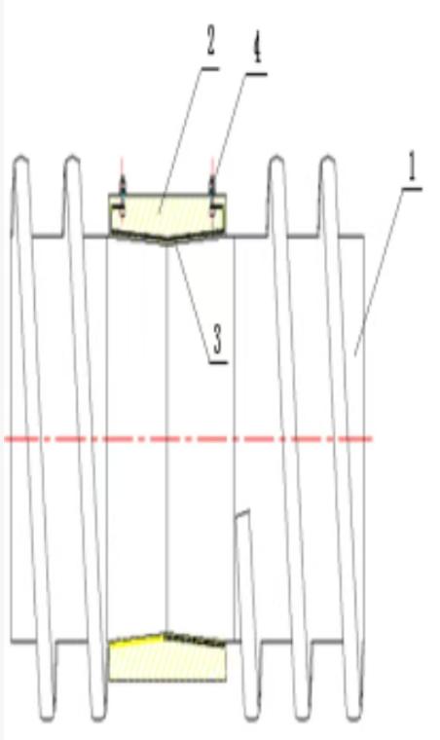
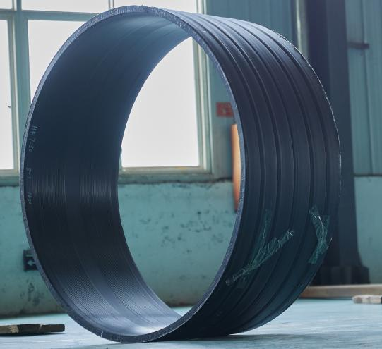
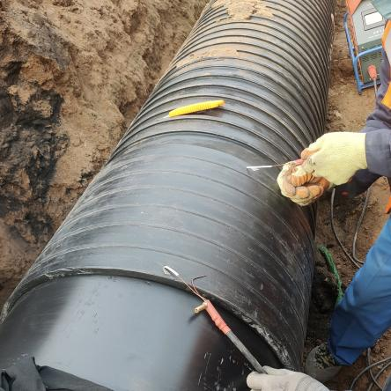
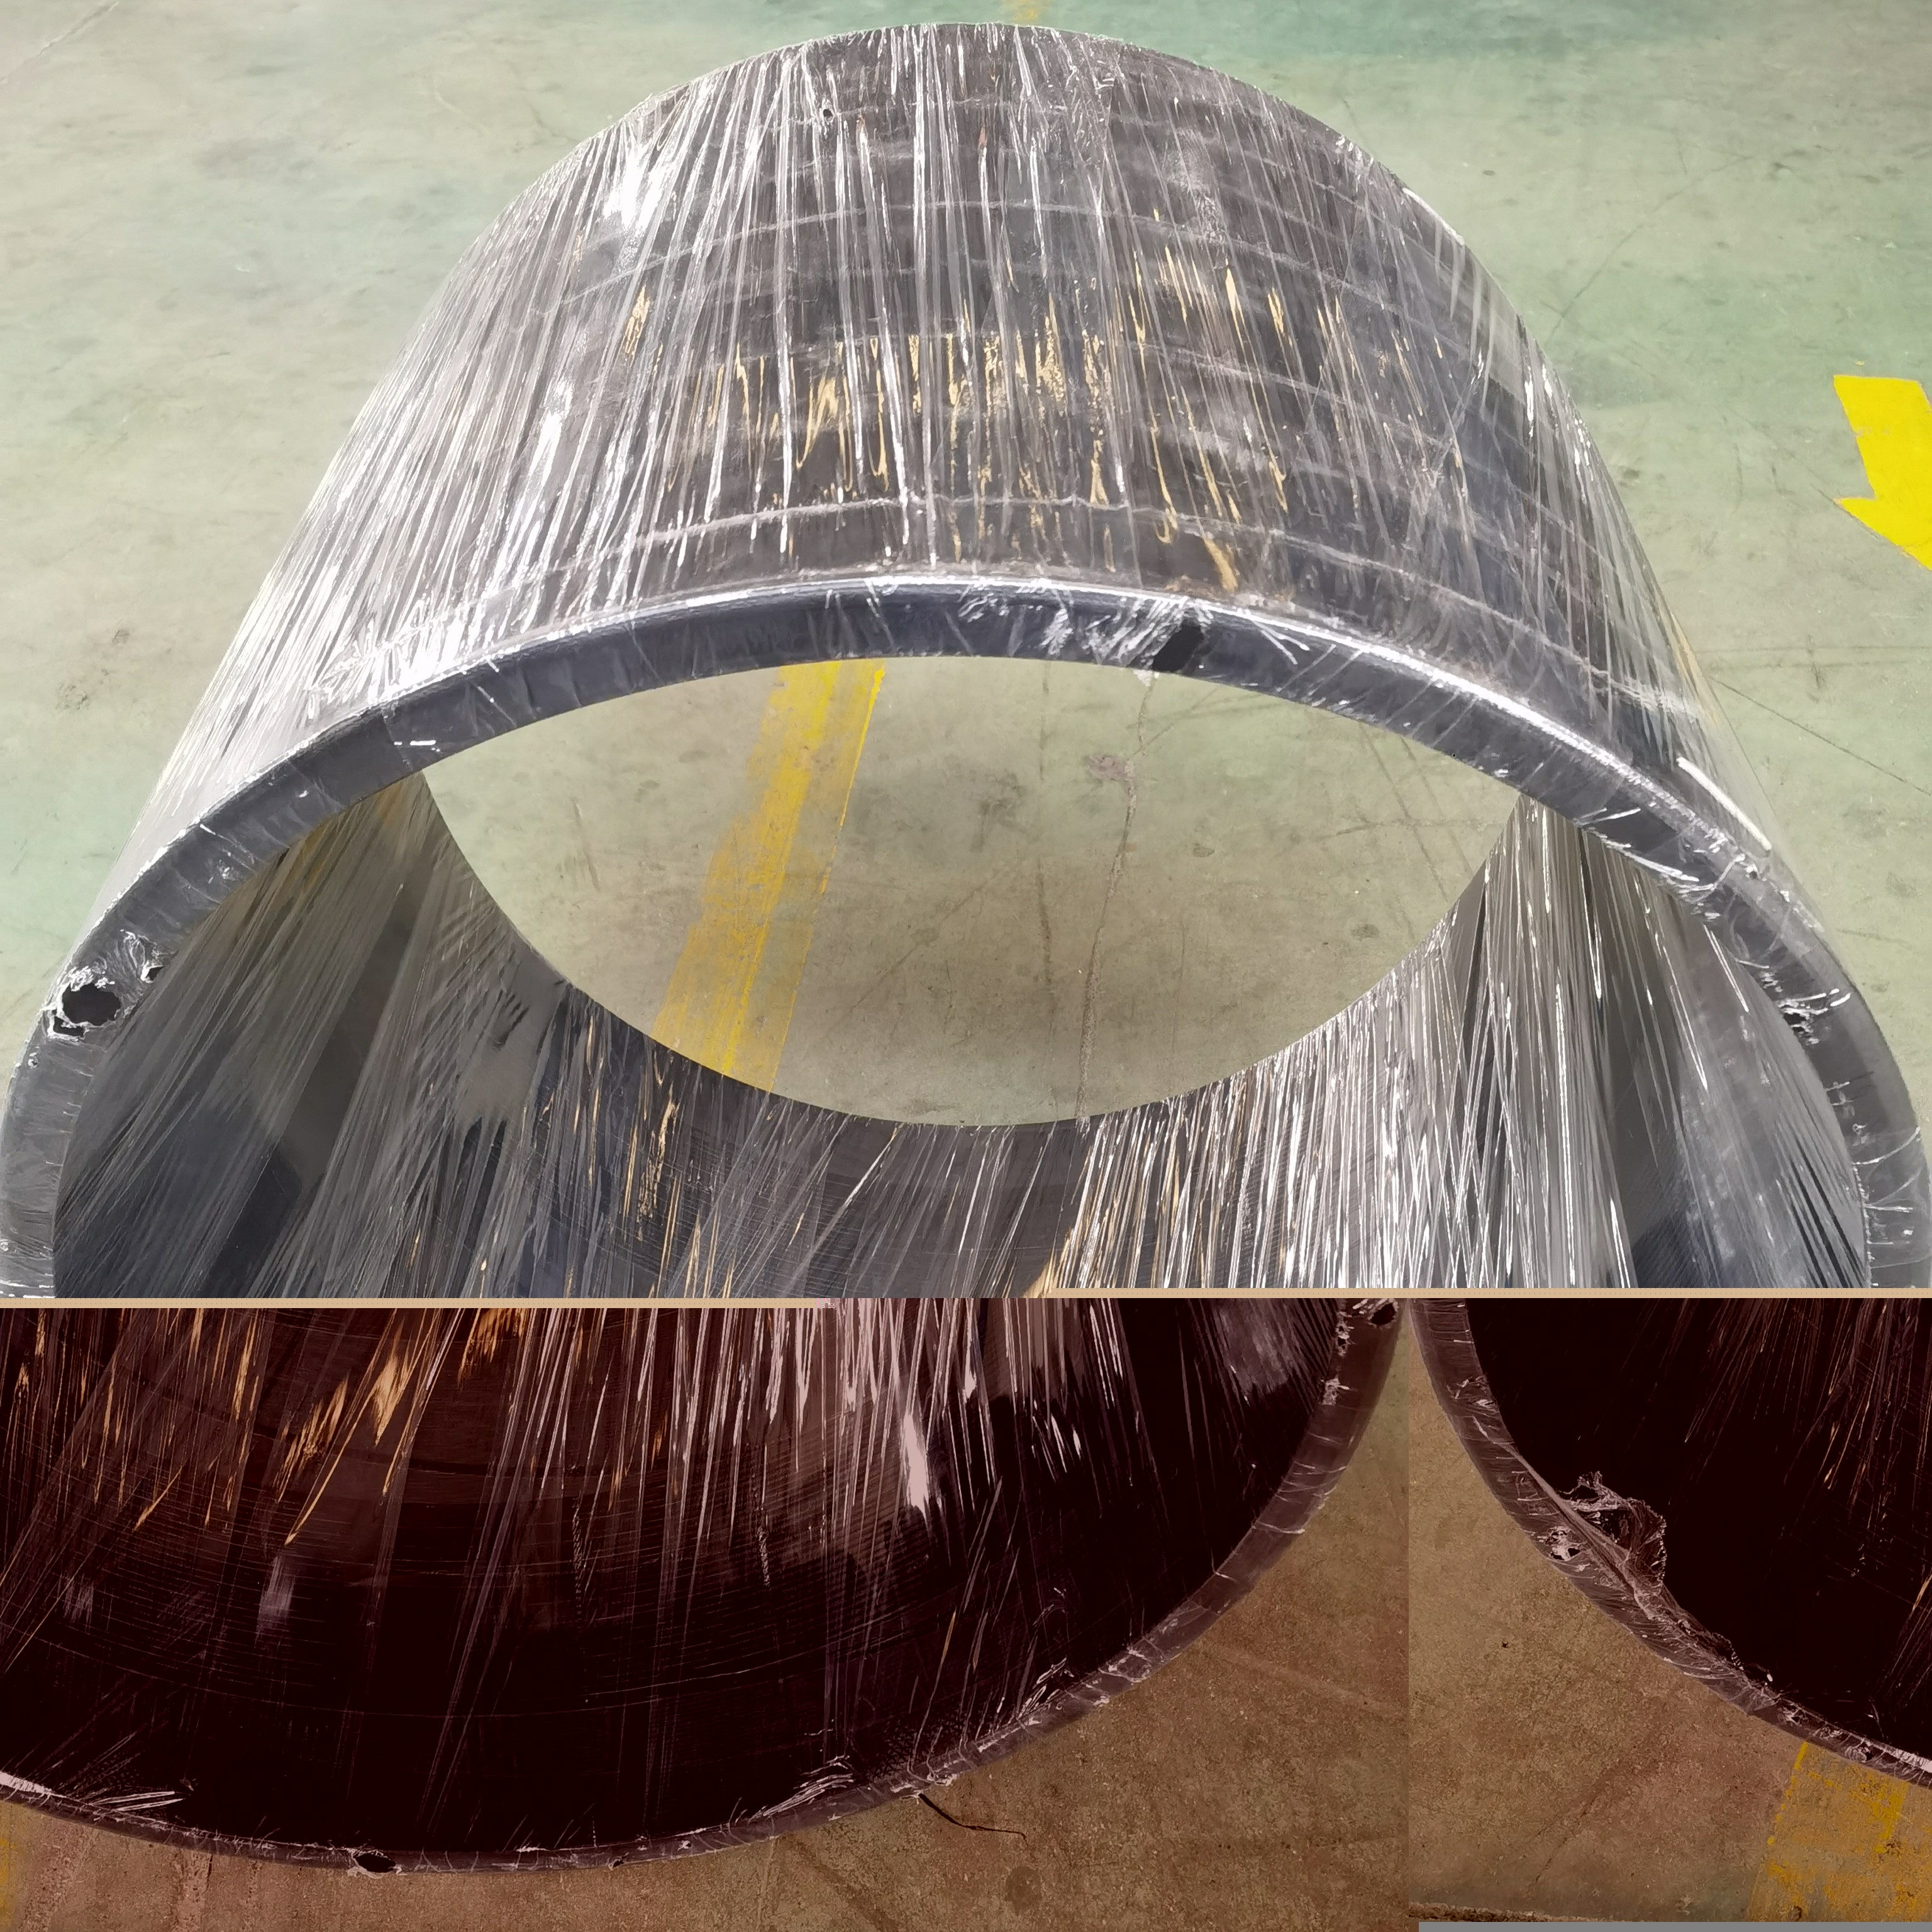
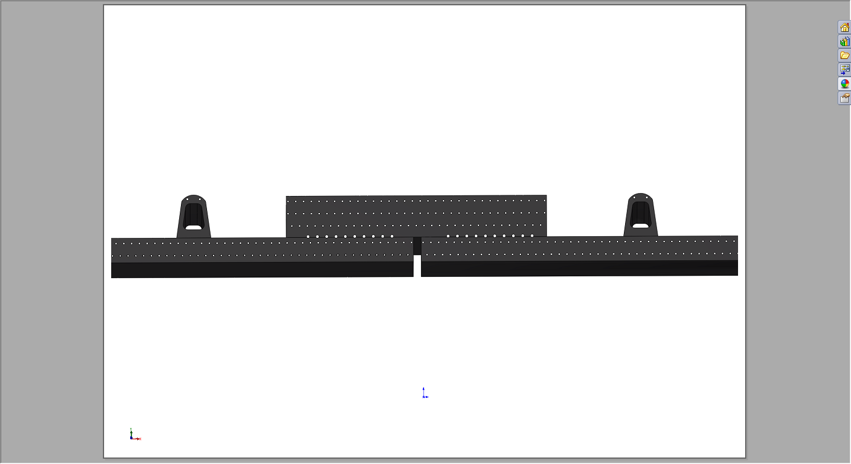
02 Reinforced PE Pipe Overview
Electrofusion Coupling
1-Pipe 2-Electro-fusion coupling
3-Conductor fitting 4-Heating wire
Electrofusion Coupling Method for Reinforced PE Composite Pipe
Notes:
我们先看海床上铺设的场景。加筋PE管的优势非常明显。它可以在岸上先焊接成几百米长的管段，然后像拖航一样整体运到海上，再慢慢沉放下去。这种方法极大地减少了海上作业时间，非常适合在养殖区施工。而PCCP管又重又刚，只能一节一节地用大吊车在海上对接，不仅效率低，而且在风浪大的时候非常危险。

Slide 7
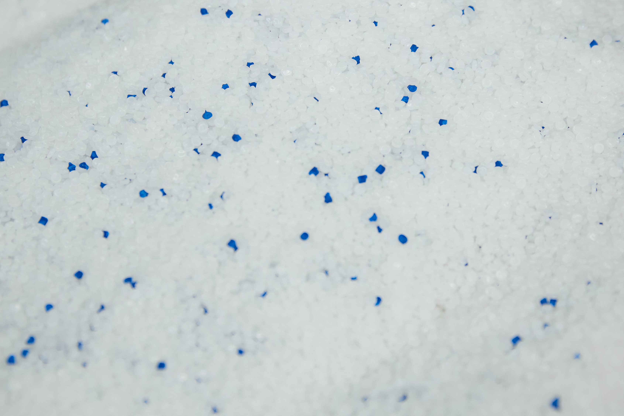
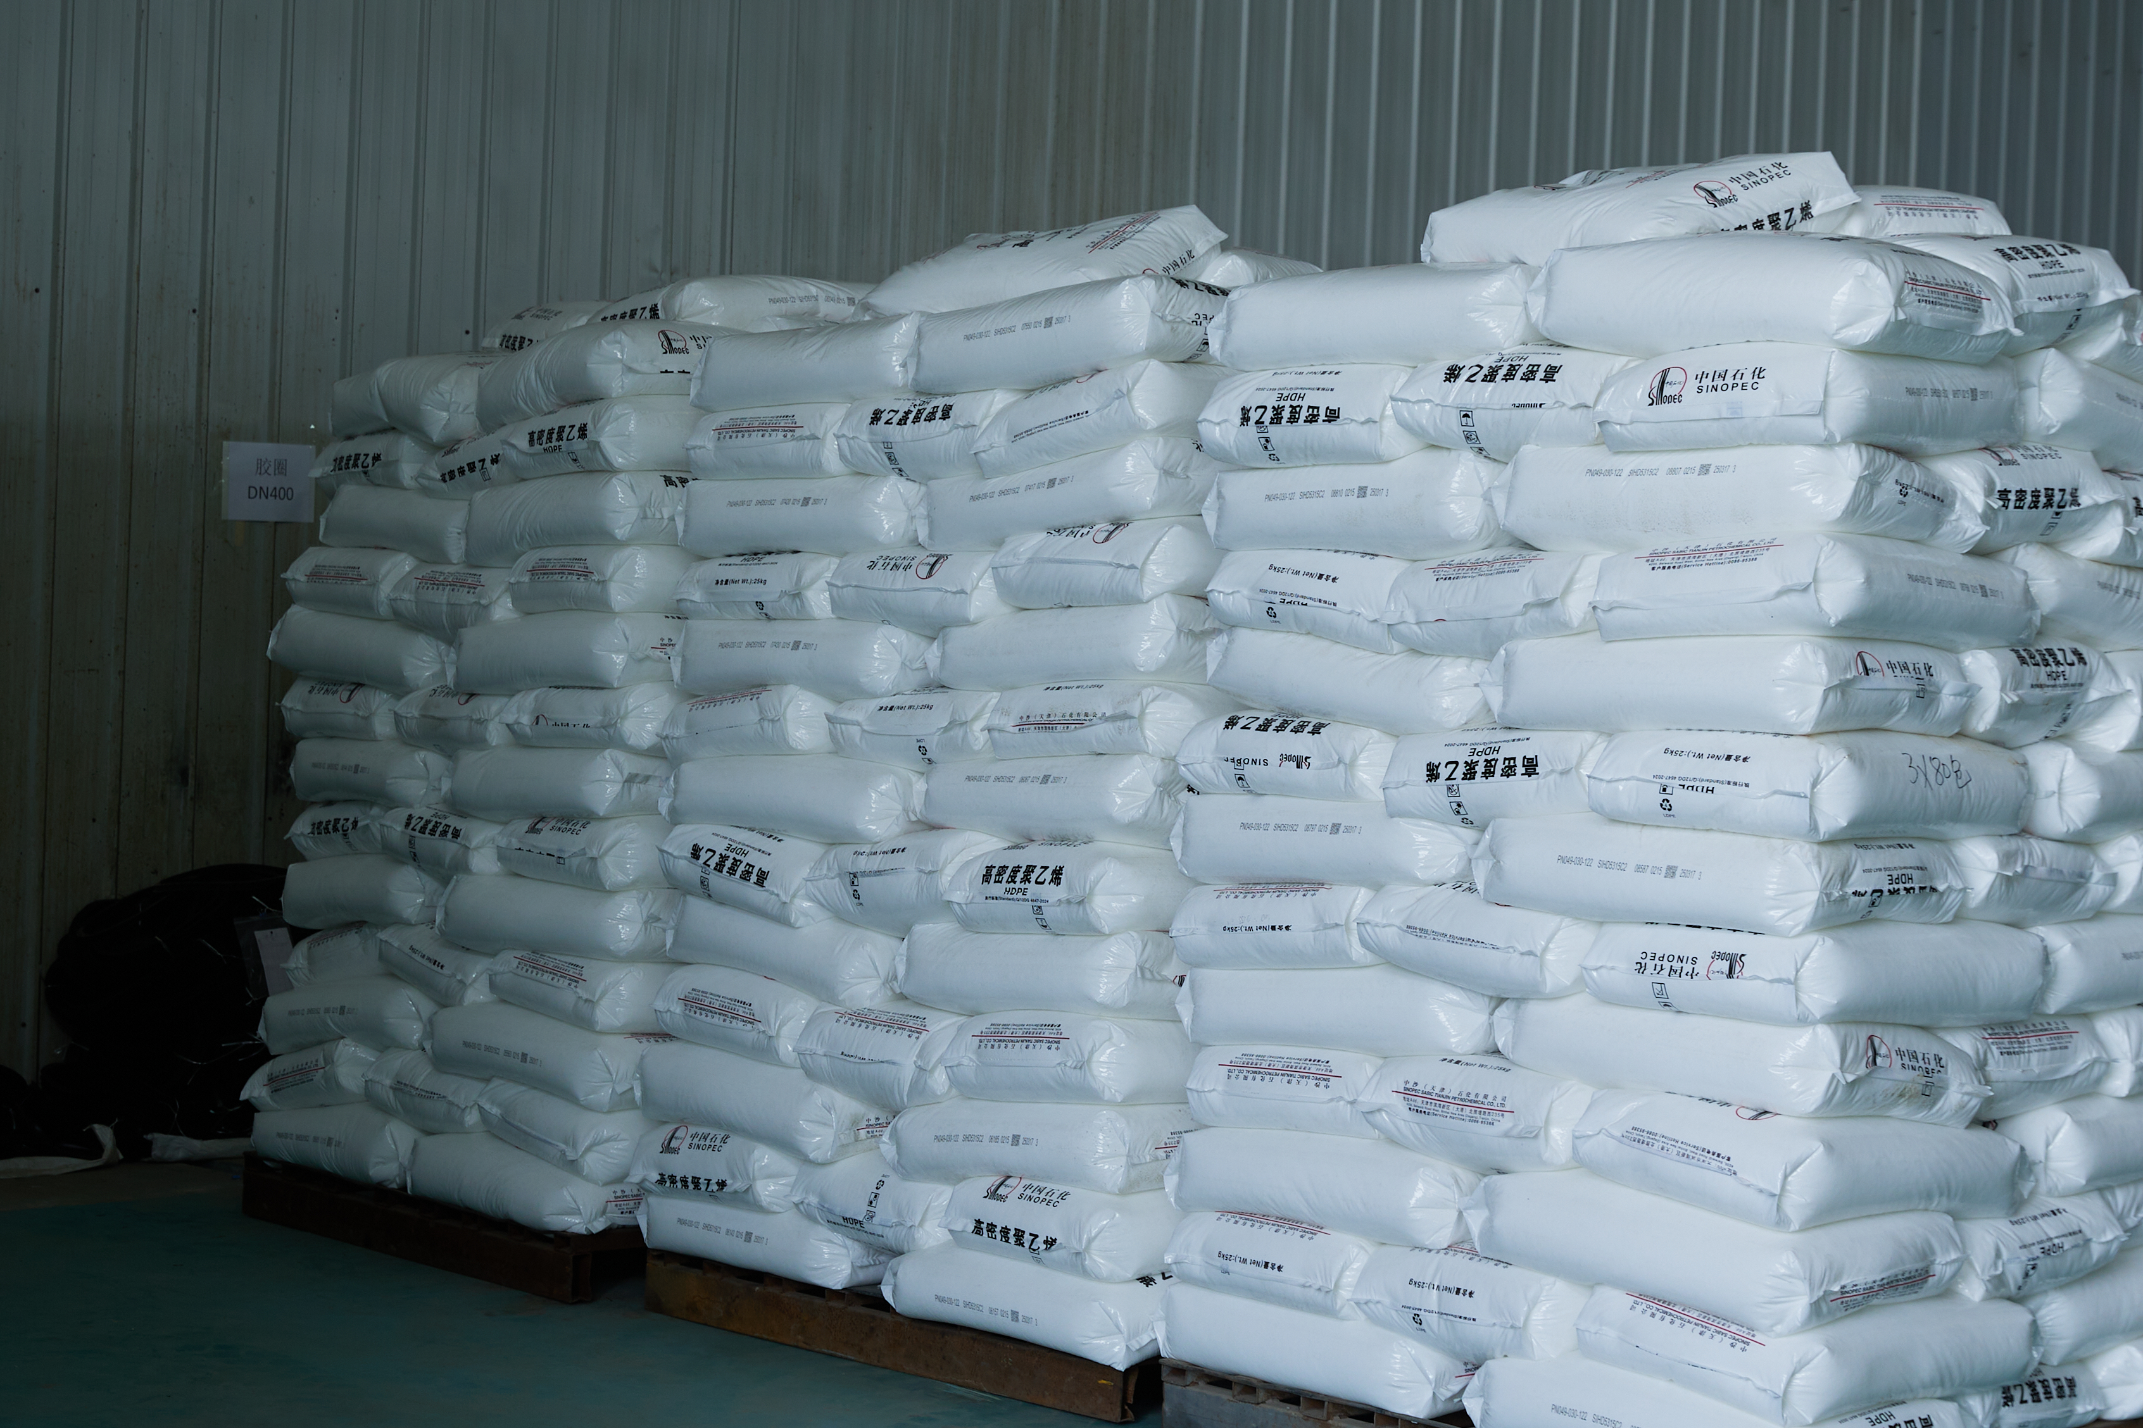
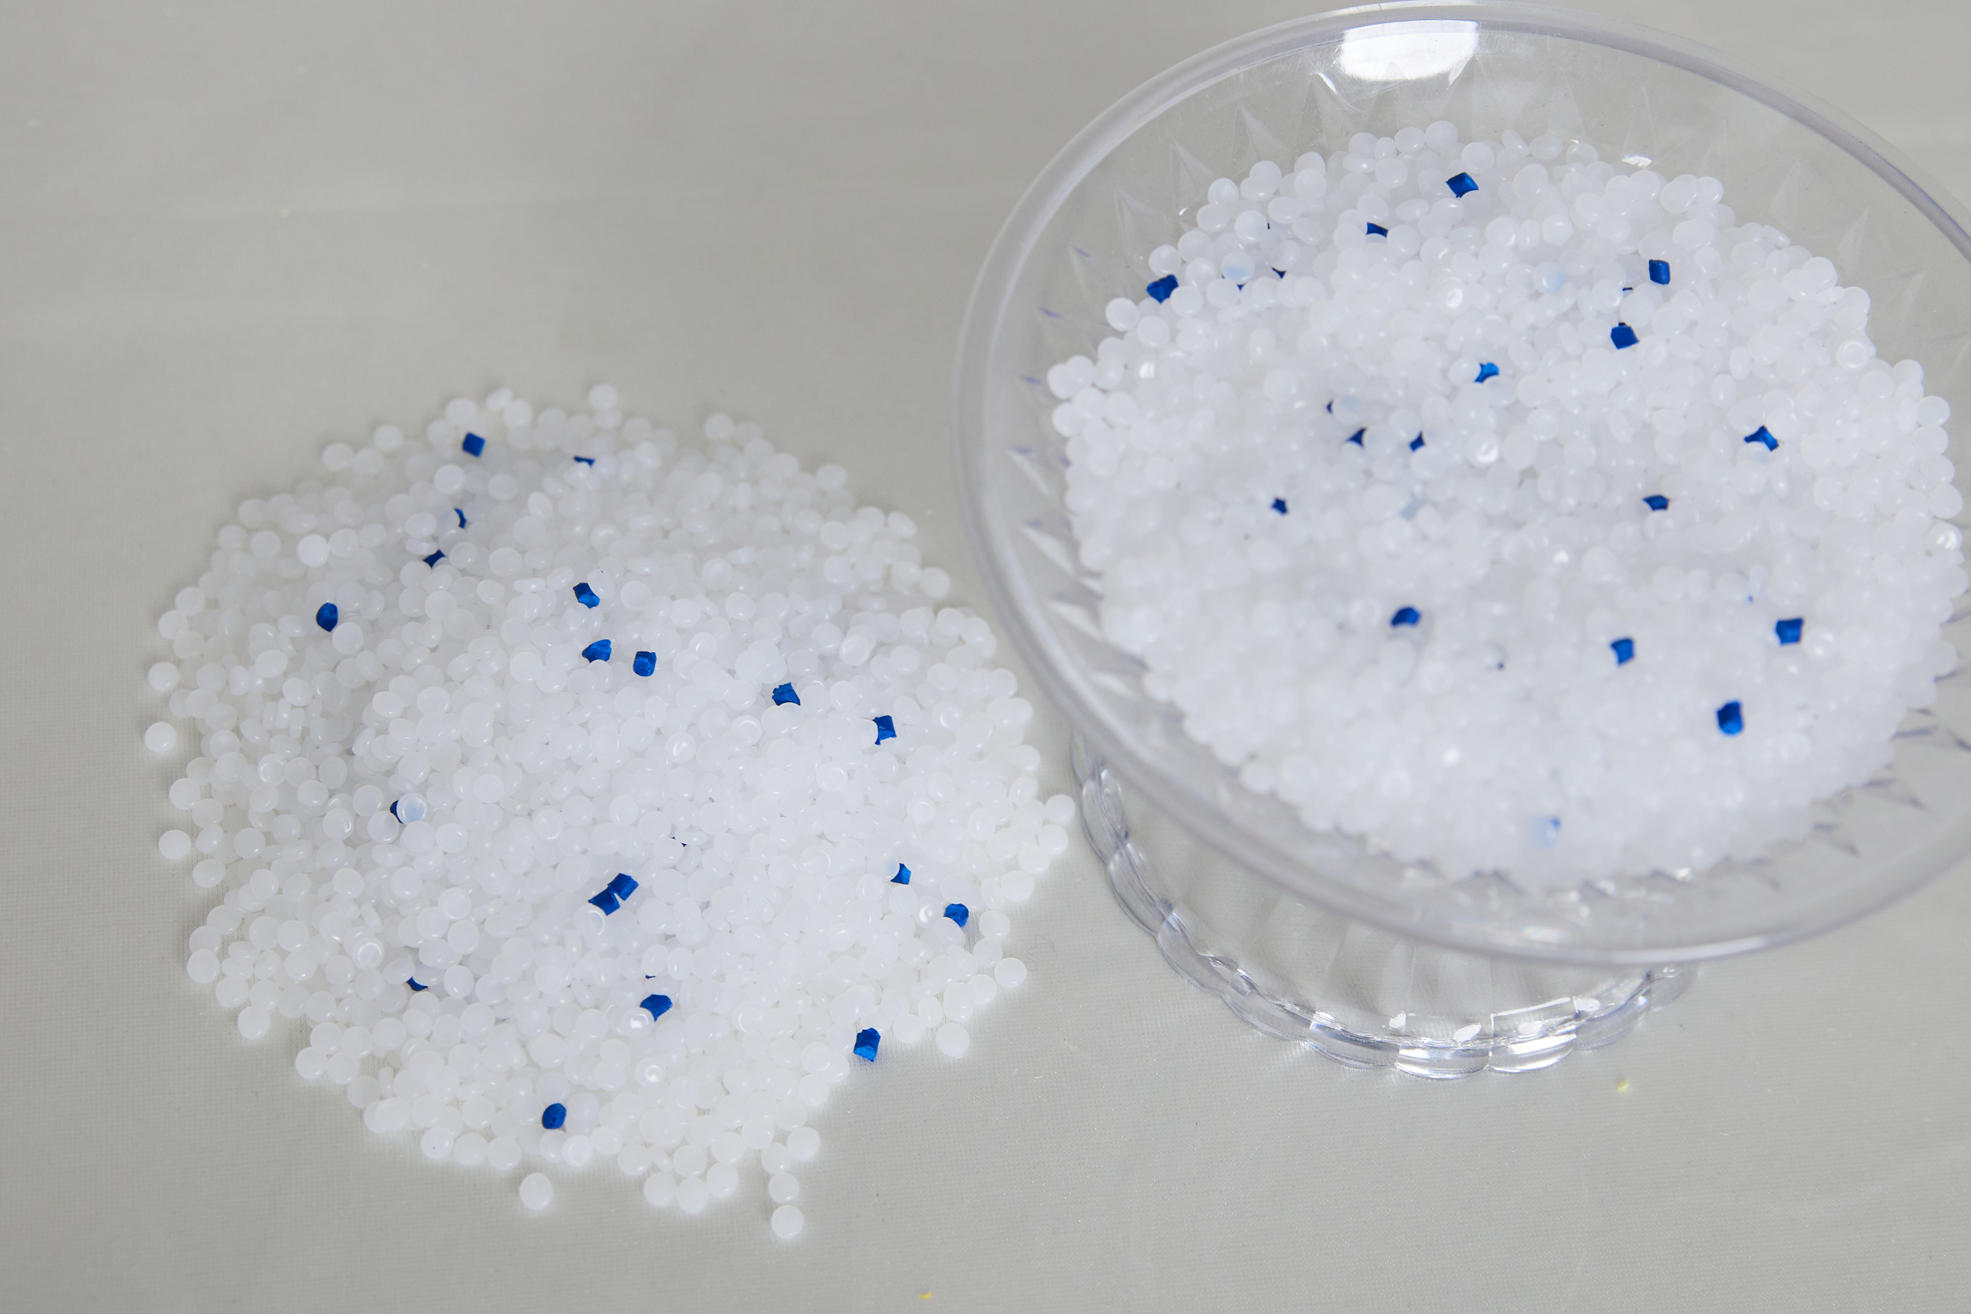
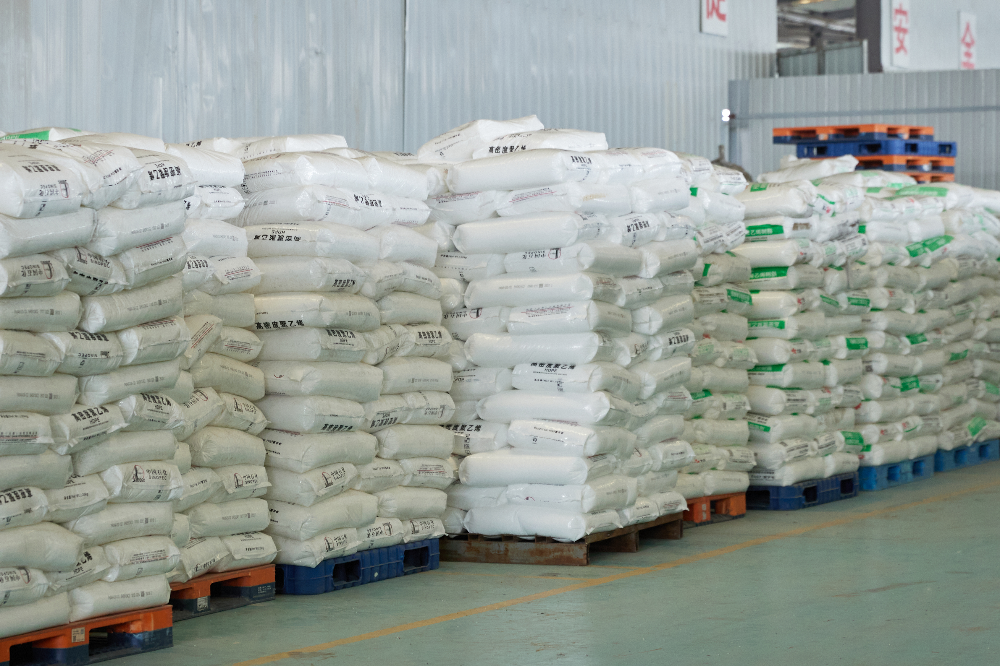
02 Reinforced PE Pipe Overview
II. Material Selection — Base Resin
We use PE resin with a molecular weight of approximately 200,000, offering excellent impact strength, tensile strength, corrosion resistance, weathering resistance, and fatigue resistance. This delivers the pipe's core performance — particularly outstanding flexibility and bond strength.
Notes:
我们先看海床上铺设的场景。加筋PE管的优势非常明显。它可以在岸上先焊接成几百米长的管段，然后像拖航一样整体运到海上，再慢慢沉放下去。这种方法极大地减少了海上作业时间，非常适合在养殖区施工。而PCCP管又重又刚，只能一节一节地用大吊车在海上对接，不仅效率低，而且在风浪大的时候非常危险。

Slide 8
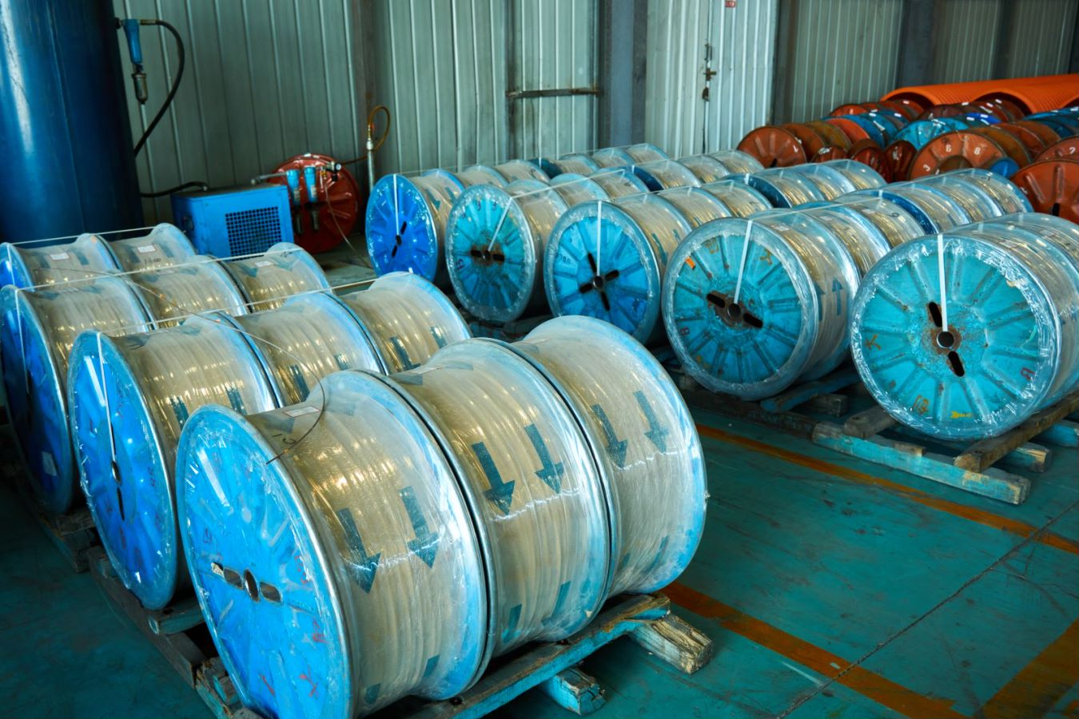
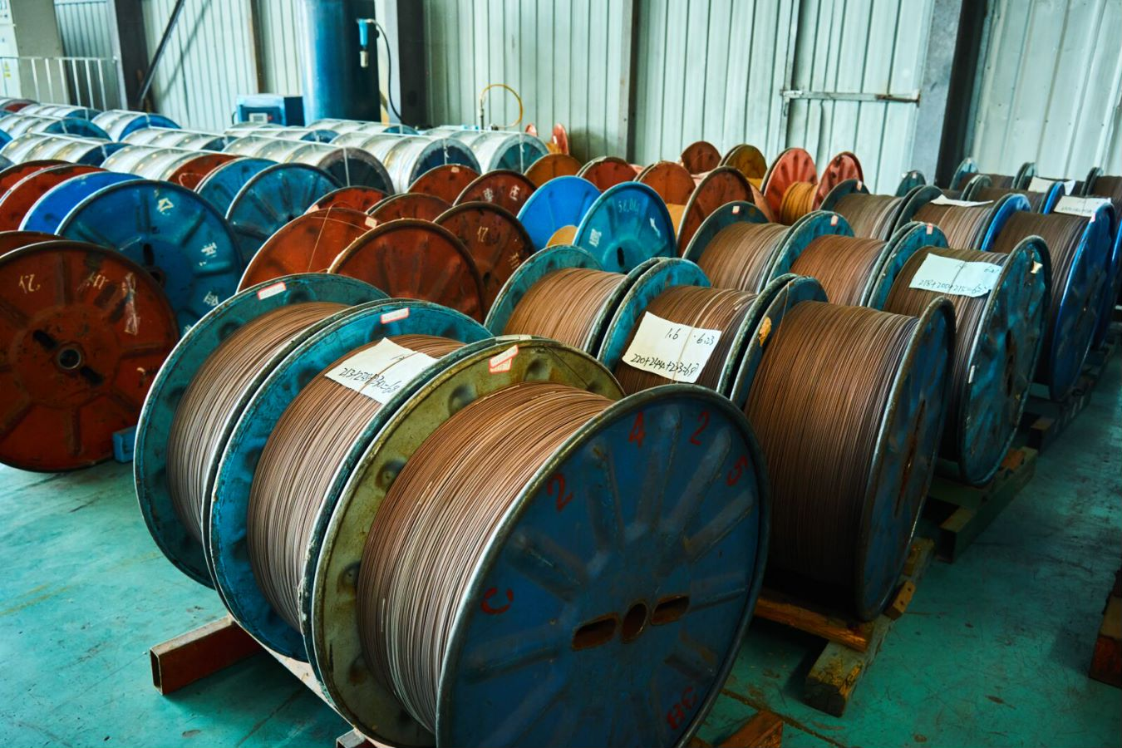
02 Reinforced PE Pipe Overview
The wire is carbon spring steel with a tensile strength of approximately 2,000 MPa. Its elastic modulus is 200 GPa — about 300 times PE's modulus of roughly 700 MPa. Both properties directly drive the pipe's pressure rating and ring stiffness.
The wire is copper-plated and pre-coated with a thin PE bonding layer before shaping, ensuring strong fusion with the PE base material and eliminating the steel/plastic delamination common in steel-strip pipe.
Notes:
我们先看海床上铺设的场景。加筋PE管的优势非常明显。它可以在岸上先焊接成几百米长的管段，然后像拖航一样整体运到海上，再慢慢沉放下去。这种方法极大地减少了海上作业时间，非常适合在养殖区施工。而PCCP管又重又刚，只能一节一节地用大吊车在海上对接，不仅效率低，而且在风浪大的时候非常危险。

Slide 9
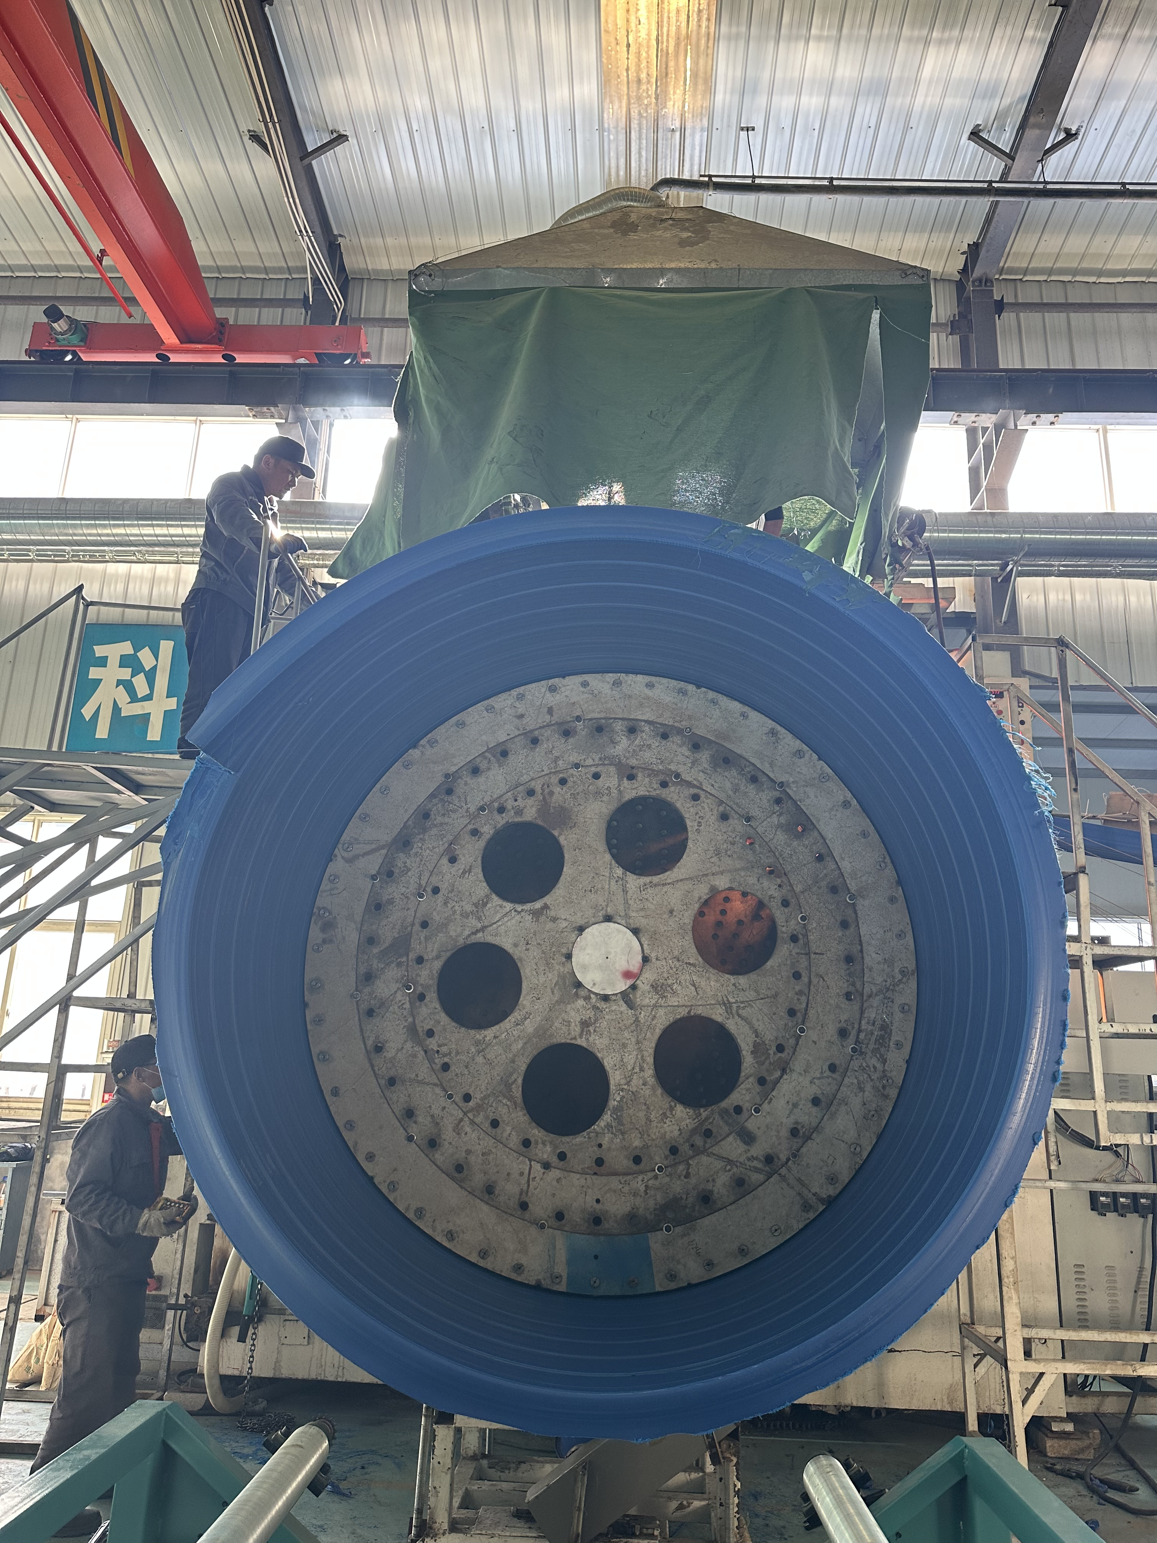
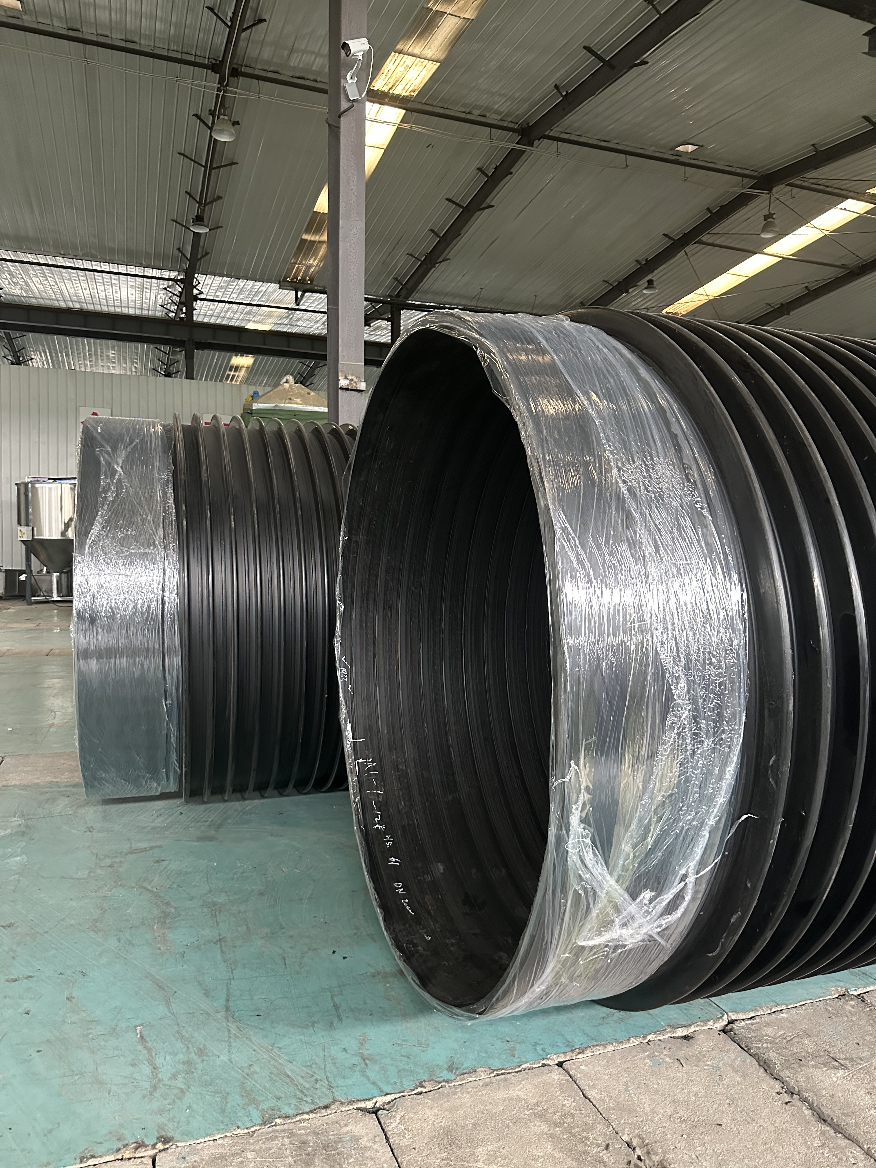
02 Reinforced PE Pipe Overview
III. Pipe Characteristics — Large Diameter
The pipe is formed by co-winding steel wire and PE strip with simultaneous heat-fusion, using a proprietary process in which the pipe body's own rotation draws in the strip material — enabling stable production of ultra-large diameters of DN3000 and above. This engineered structure and premium material selection can meet virtually any strength requirement a project demands.
Our next-generation large-diameter PE composite water/wastewater pipe fills multiple gaps in China's domestic PE piping industry.
Notes:
我们先看海床上铺设的场景。加筋PE管的优势非常明显。它可以在岸上先焊接成几百米长的管段，然后像拖航一样整体运到海上，再慢慢沉放下去。这种方法极大地减少了海上作业时间，非常适合在养殖区施工。而PCCP管又重又刚，只能一节一节地用大吊车在海上对接，不仅效率低，而且在风浪大的时候非常危险。

Slide 10
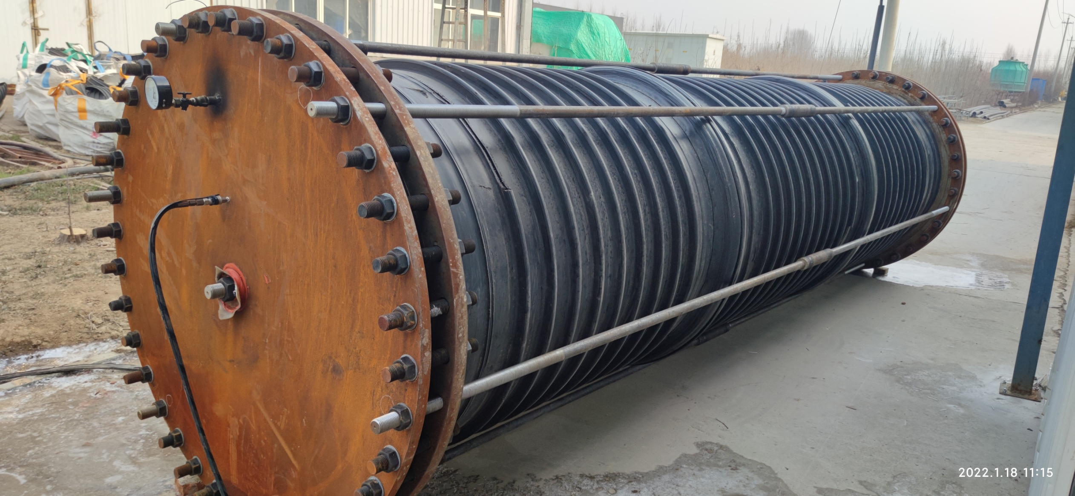
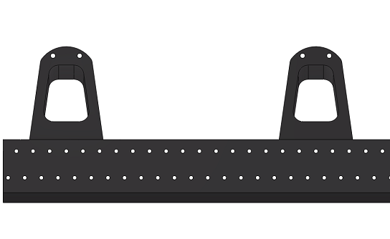
02 Reinforced PE Pipe Overview
Pipe Characteristics — Pressure Rating & High Ring Stiffness
Steel wire is arranged in multiple concentric layers inside the pipe wall, with an additional reinforcing layer at the tip of each rib. PE spacers separate the wire layers, creating void spaces that effectively increase the wall's bending thickness. For a homogeneous pipe, ring stiffness scales with wall thickness cubed — doubling wall thickness increases stiffness 8x. This pipe is a non-homogeneous steel/PE composite, but its multi-layer wire arrangement achieves an equivalent high-strength reinforcing effect.
The PE matrix's flexibility allows steel wire to be continuously wound circumferentially, nearly perpendicular to the pipe axis. Combined with large-gauge, high-strength wire, this efficiently carries external hoop loads, substantially improving resistance to external pressure and deformation.
Pipe Axial Cross-Section
Notes:
我们先看海床上铺设的场景。加筋PE管的优势非常明显。它可以在岸上先焊接成几百米长的管段，然后像拖航一样整体运到海上，再慢慢沉放下去。这种方法极大地减少了海上作业时间，非常适合在养殖区施工。而PCCP管又重又刚，只能一节一节地用大吊车在海上对接，不仅效率低，而且在风浪大的时候非常危险。

Slide 11
02 Reinforced PE Pipe Overview
Pipe Characteristics — Acid/Alkali & Corrosion Resistance
The pipe matrix uses specialty linear HDPE with a long-chain saturated molecular structure for stable physical and chemical properties. It resists acids, alkalis, salts, and organic solvents under typical temperature/concentration conditions — well suited to corrosive media like seawater.
The internal copper-plated reinforcing wire is fully encapsulated by the PE matrix, with no exposure and no gaps — isolating it from external media and eliminating the wire corrosion that would otherwise shorten service life. Wire is plastic-coated before shaping, adding a bonding-transition PE layer over the copper plating that both protects the wire and ensures compatibility at the PE fusion interface.
Our proprietary composite-forming process fully fuses wire and PE into one integrated structure, avoiding the delamination that steel/plastic property mismatches can cause. Even after prolonged exposure to highly corrosive seawater, the internal wire structure stays sound, and the tightly bonded composite significantly improves impact resistance.
The PE base material offers excellent aging and weathering resistance; buried pipe has a standard design life of up to 50 years.
Notes:
我们先看海床上铺设的场景。加筋PE管的优势非常明显。它可以在岸上先焊接成几百米长的管段，然后像拖航一样整体运到海上，再慢慢沉放下去。这种方法极大地减少了海上作业时间，非常适合在养殖区施工。而PCCP管又重又刚，只能一节一节地用大吊车在海上对接，不仅效率低，而且在风浪大的时候非常危险。

Slide 12
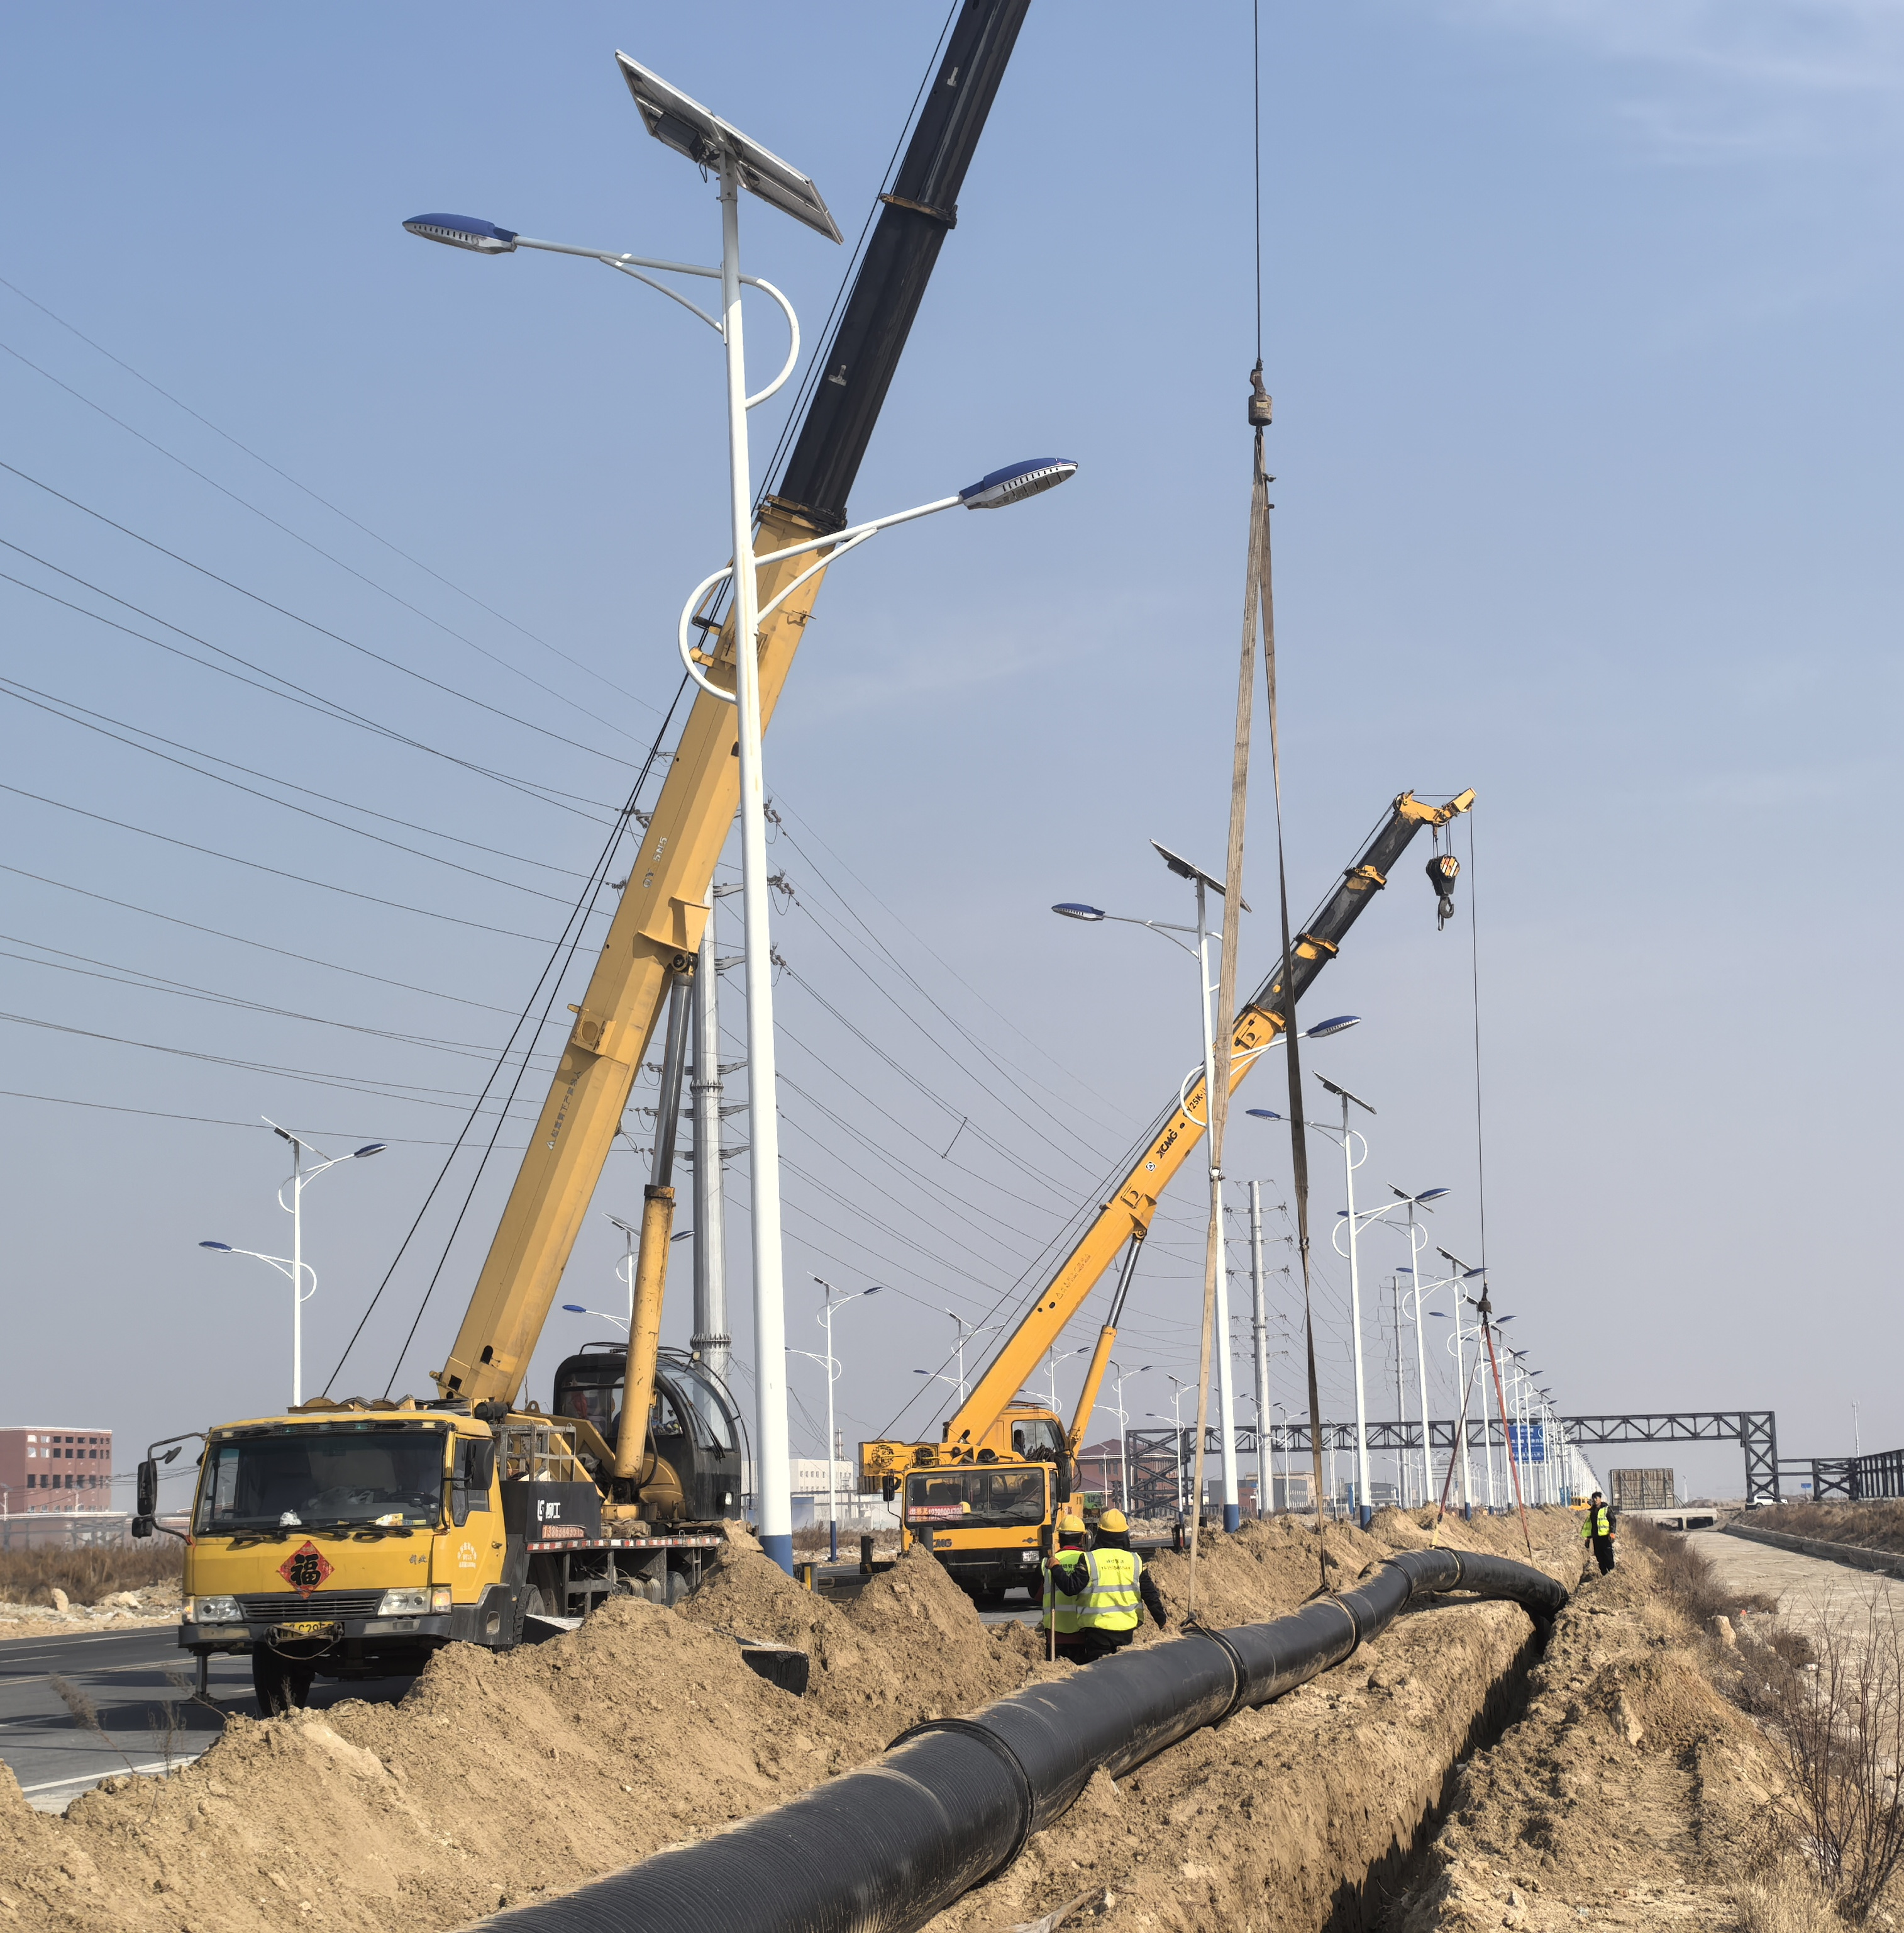
02 Reinforced PE Pipe Overview
Pipe Characteristics — Flexibility & Bendability
Reinforced PE composite pipe retains PE's inherent flexibility. Single-direction wire winding creates a spring-like structure in the wall that preserves longitudinal stretch and bend capability, allowing a minimum bend radius of just 30x the pipe diameter. This prevents joint-stress cracking during bending, absorbs thermal expansion/contraction, and mitigates damage from ground settlement.
The continuous winding process runs on a single production line, yielding 12–20 m sections per run — saving labor and time and lowering installation costs.
Pipe Bendability
Notes:
我们先看海床上铺设的场景。加筋PE管的优势非常明显。它可以在岸上先焊接成几百米长的管段，然后像拖航一样整体运到海上，再慢慢沉放下去。这种方法极大地减少了海上作业时间，非常适合在养殖区施工。而PCCP管又重又刚，只能一节一节地用大吊车在海上对接，不仅效率低，而且在风浪大的时候非常危险。

Slide 13
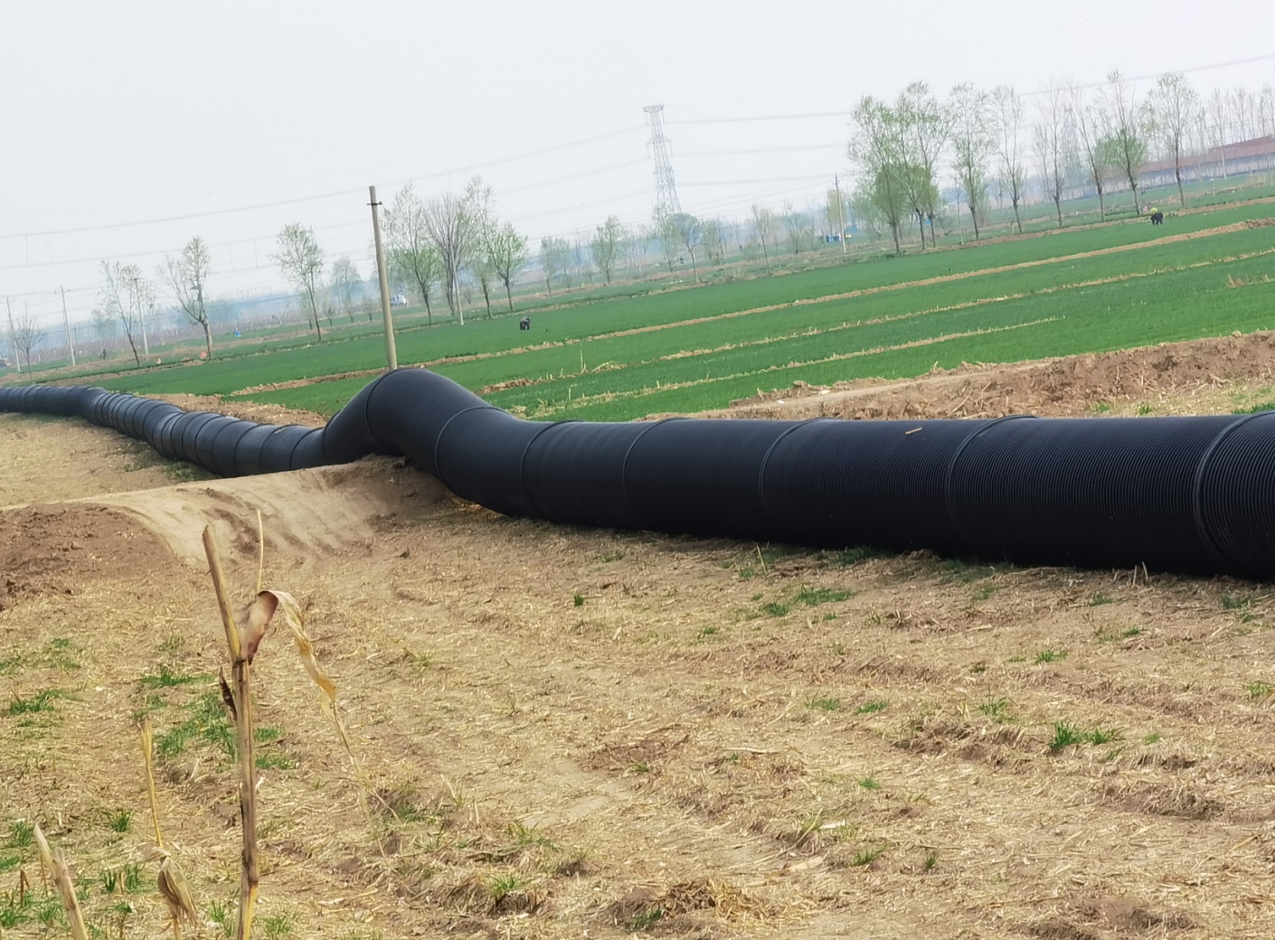
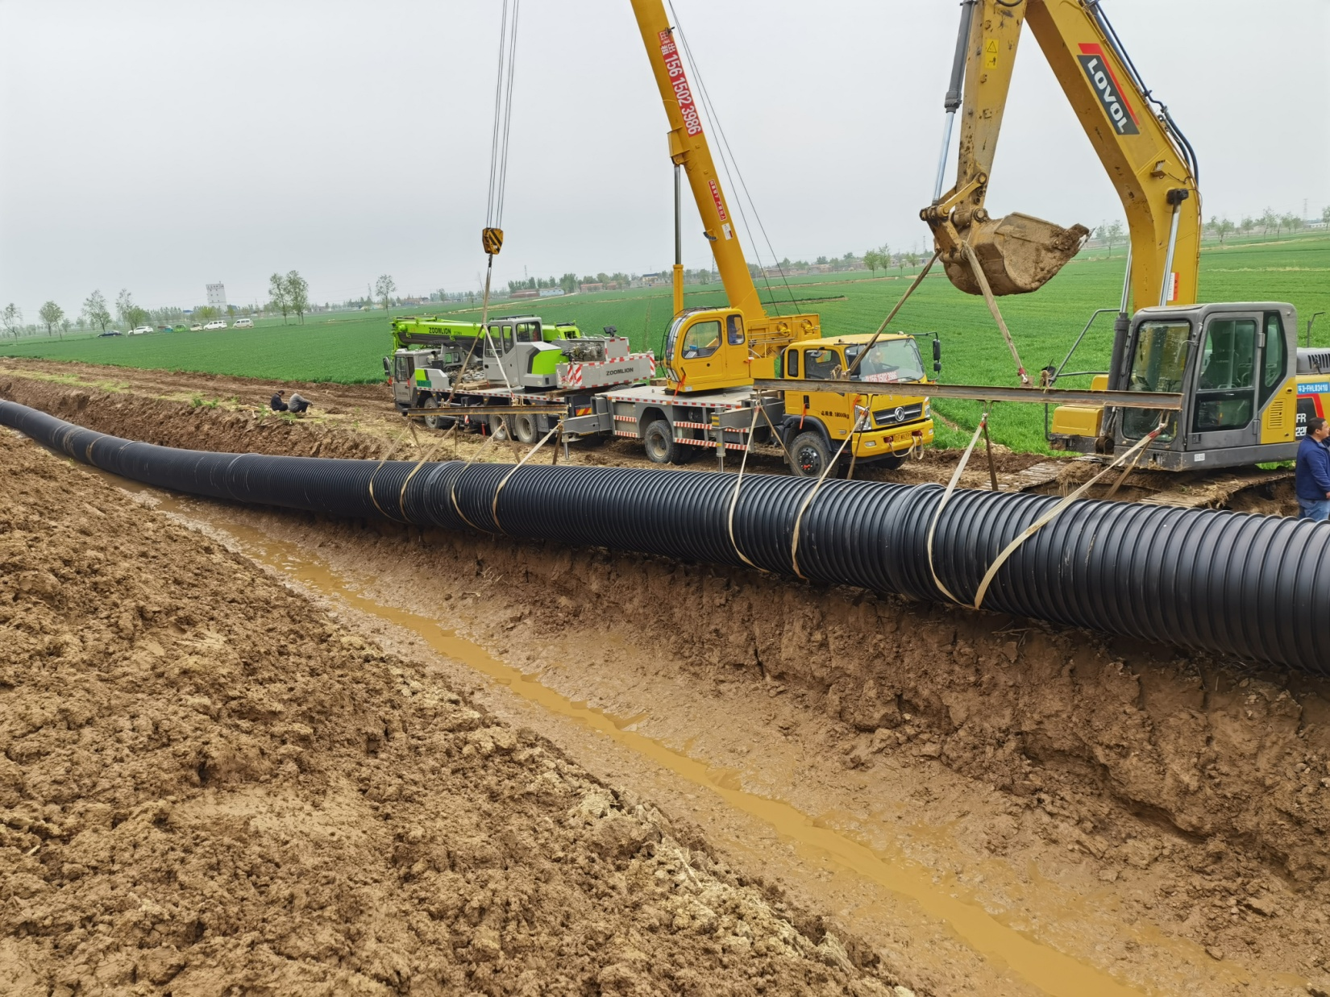
02 Reinforced PE Pipe Overview
Flexibility of Reinforced PE Composite Pipe
Notes:
我们先看海床上铺设的场景。加筋PE管的优势非常明显。它可以在岸上先焊接成几百米长的管段，然后像拖航一样整体运到海上，再慢慢沉放下去。这种方法极大地减少了海上作业时间，非常适合在养殖区施工。而PCCP管又重又刚，只能一节一节地用大吊车在海上对接，不仅效率低，而且在风浪大的时候非常危险。

Slide 14
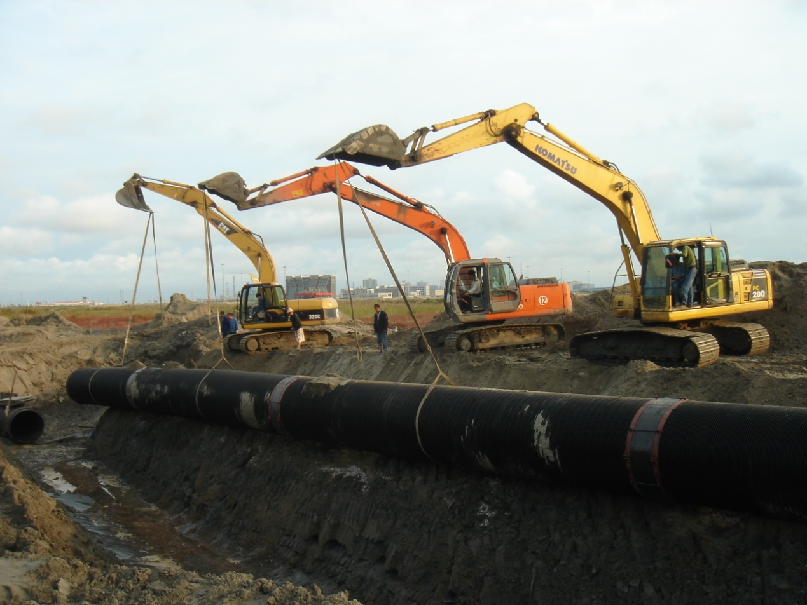
02 Reinforced PE Pipe Overview
Pipe Characteristics — Abrasion Resistance
Made from high-molecular-weight PE resin, reinforced PE pipe offers the best abrasion resistance of any metallic or non-metallic pipe material. It resists internal wall wear from particulates in the flow, and plankton, barnacles, mussels, and algae adhere poorly to its surface — supporting a long service life.
Notes:
我们先看海床上铺设的场景。加筋PE管的优势非常明显。它可以在岸上先焊接成几百米长的管段，然后像拖航一样整体运到海上，再慢慢沉放下去。这种方法极大地减少了海上作业时间，非常适合在养殖区施工。而PCCP管又重又刚，只能一节一节地用大吊车在海上对接，不仅效率低，而且在风浪大的时候非常危险。

Slide 15
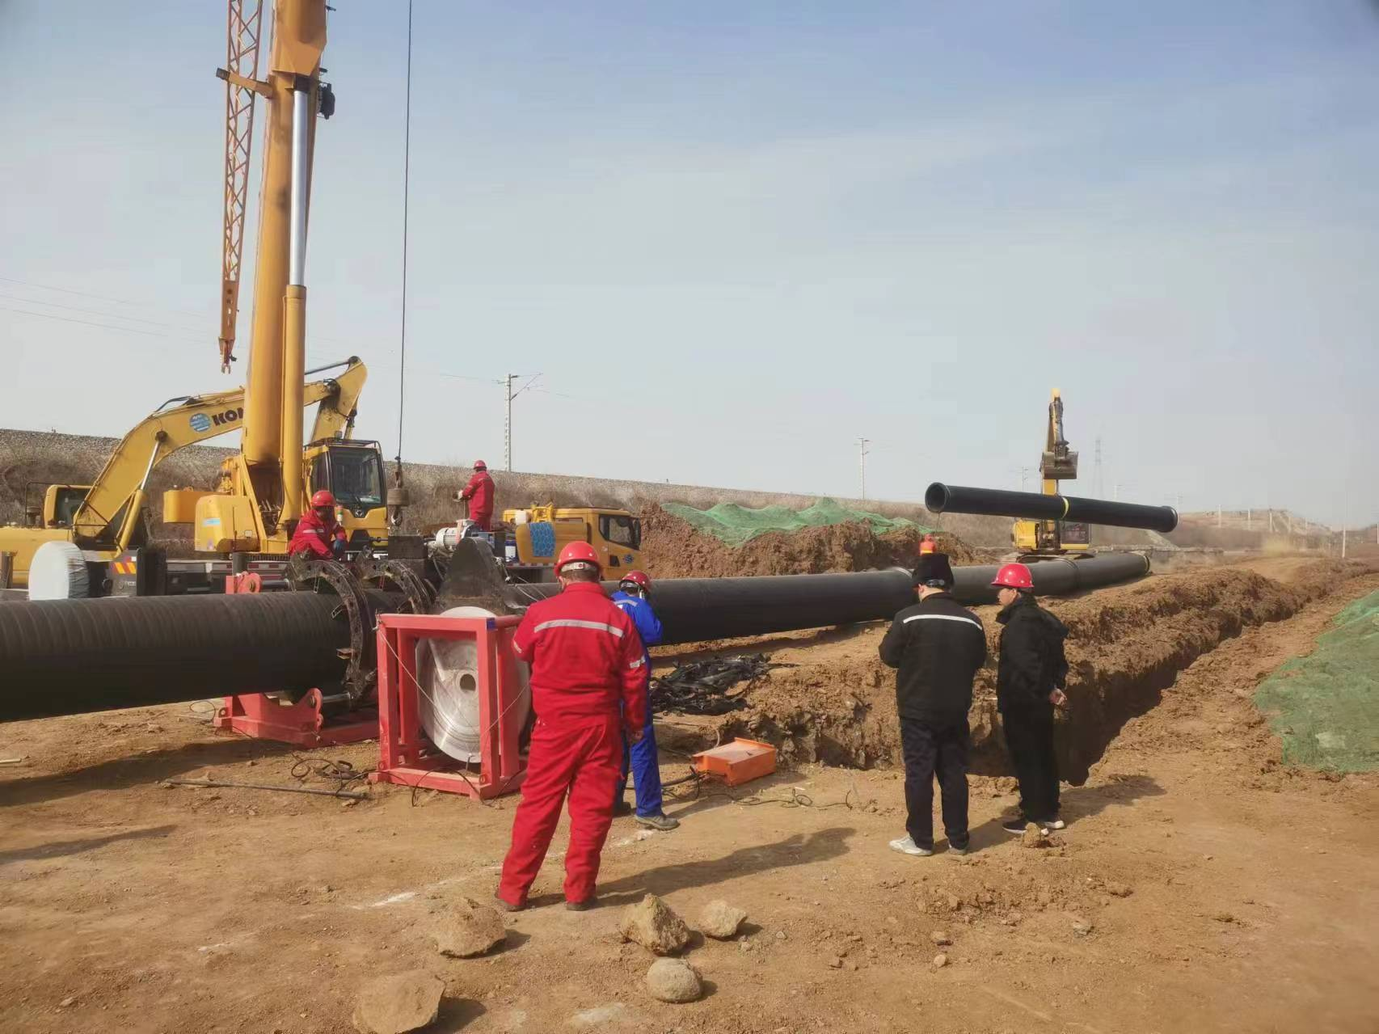
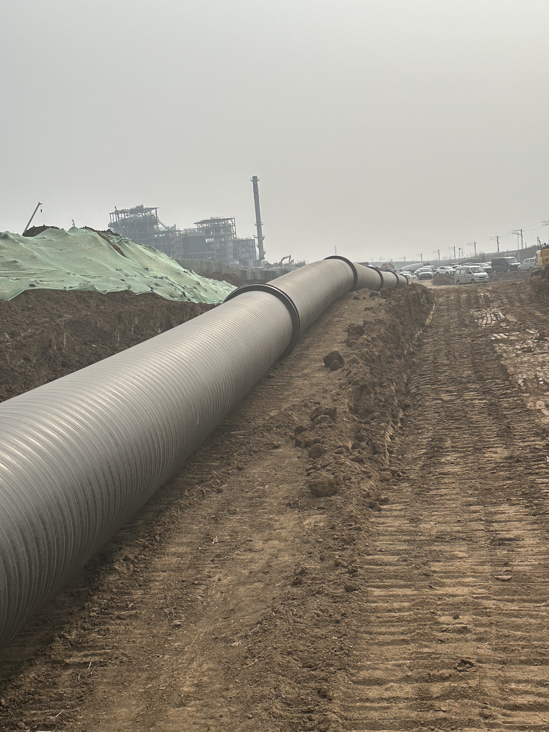
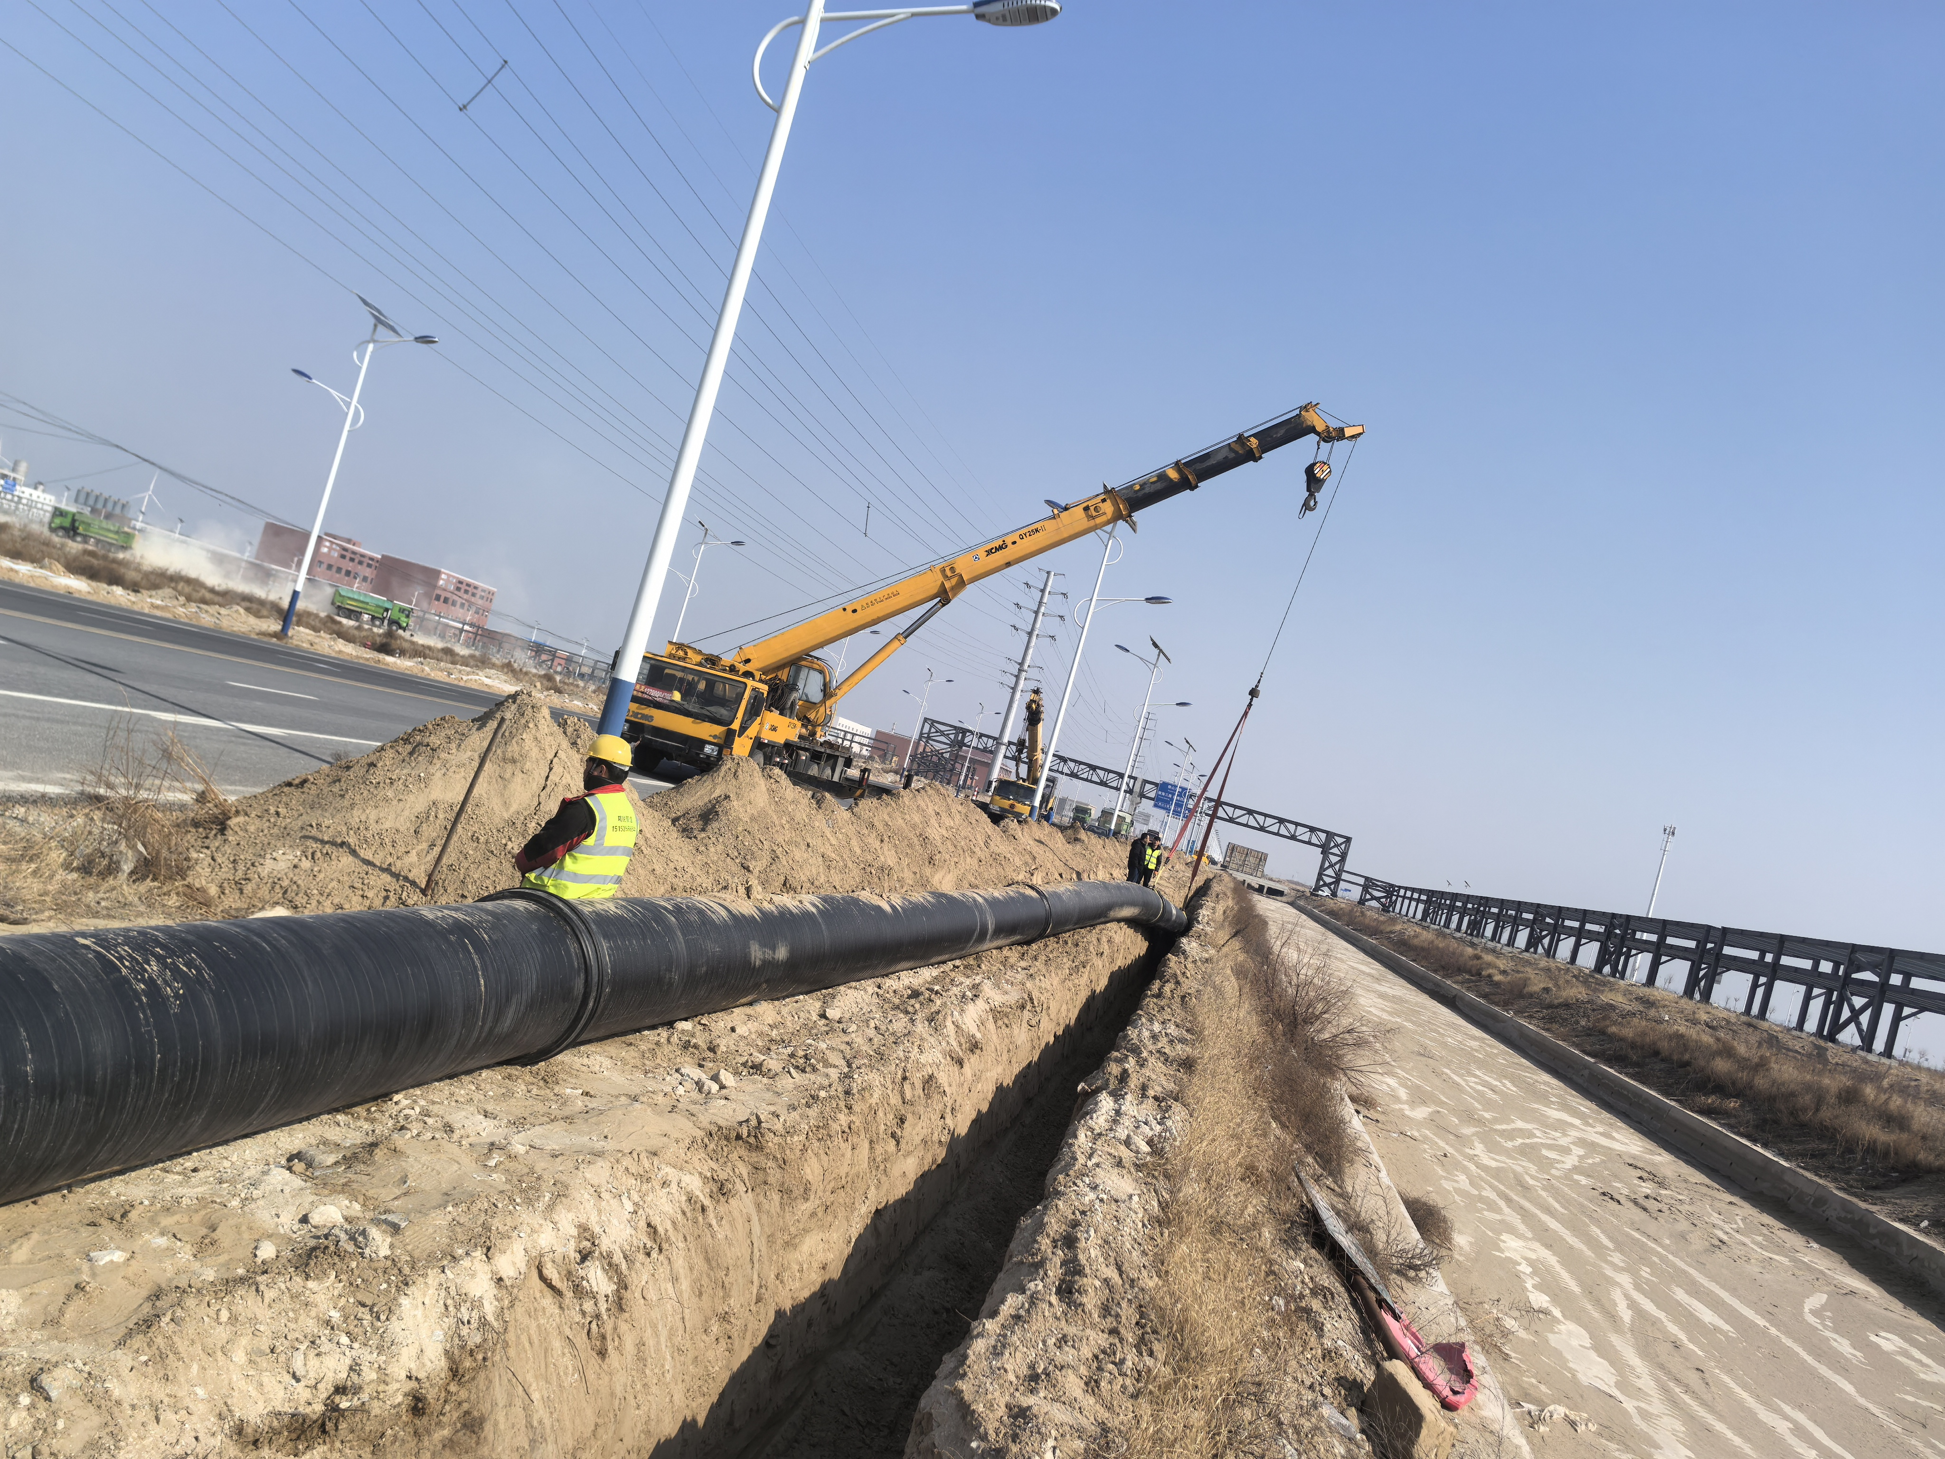
02 Reinforced PE Pipe Overview
Pipe Characteristics — Ease of Installation
Joined by coupling or butt-fusion welding, reinforced PE pipe requires minimal technical skill and no heavy equipment. Its flexibility eliminates the need for a separate foundation or corrosion coating. Sections can be joined onshore and towed into the trench/channel, keeping installation costs low.
Notes:
我们先看海床上铺设的场景。加筋PE管的优势非常明显。它可以在岸上先焊接成几百米长的管段，然后像拖航一样整体运到海上，再慢慢沉放下去。这种方法极大地减少了海上作业时间，非常适合在养殖区施工。而PCCP管又重又刚，只能一节一节地用大吊车在海上对接，不仅效率低，而且在风浪大的时候非常危险。

Slide 16
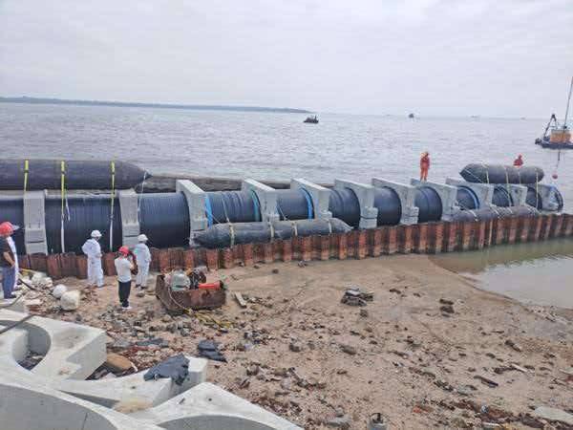
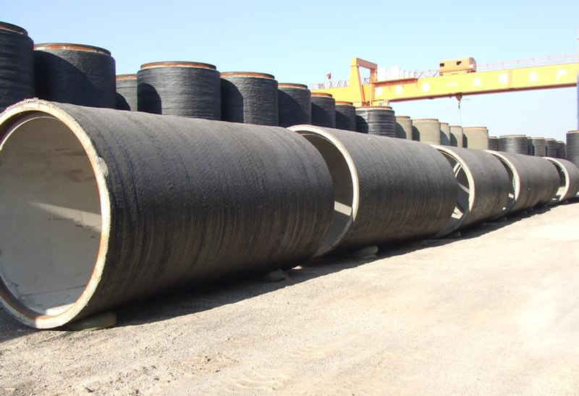
03 Reinforced PE Pipe vs. PCCP — Below-Seabed (Buried) Installation
Reinforced PE Pipe —Corrosion-Resistant, High Strength, Flexible, Easy to Install
PCCP Pipe —Rigid, Heavy, Clear Limitations
Onshore-Prefabricated Extra-Long Sections (12 m each)
PCCP installation is significantly more difficult: heavy pipe weight and short section lengths require large cranes; tide and wave conditions sharply limit the workable window; joints demand tight alignment tolerances, so misalignment causes rework and leak risk; and it requires strict seabed leveling and backfill standards, driving up long-term O&M costs.
Because PE pipe is buried below the seabed, scouring isn't a concern. Sections can be prefabricated onshore up to hundreds — even thousands — of meters long, then installed in a single float-and-sink operation with very few underwater joints, dramatically cutting underwater work risk. For subsea seawater applications, PE installation is far simpler, faster, and more cost-effective than PCCP.
Notes:
我们先看海床上铺设的场景。加筋PE管的优势非常明显。它可以在岸上先焊接成几百米长的管段，然后像拖航一样整体运到海上，再慢慢沉放下去。这种方法极大地减少了海上作业时间，非常适合在养殖区施工。而PCCP管又重又刚，只能一节一节地用大吊车在海上对接，不仅效率低，而且在风浪大的时候非常危险。

Slide 17
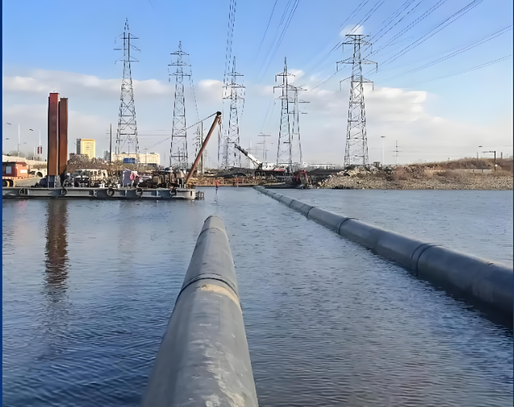
03 Reinforced PE Pipe vs. PCCP — On-Seabed (Surface-Laid) Installation
Reinforced PE Pipe:
PE pipe laid directly on the seabed only needs a buoyancy/anchoring solution — all core advantages are retained and clearly evident.
Core advantages: excellent acid/alkali and corrosion resistance, long service life, high flexibility, easy installation.
PCCP Pipe:
PCCP's only remaining advantage: its own weight satisfies buoyancy requirements.
Significantly Amplified Risks & Drawbacks:
1. Corrosion accelerates sharply, cutting service life dramatically.
2. Seabed scouring can cause pipe breakage.
3. Higher joint-leak risk.
4. Heavy O&M burden; poor fit for aquaculture applications.
Once damaged, it cannot be repaired underwater and must be fully replaced — causing major production downtime losses.
Notes:
再来看海床下埋设的场景。加筋PE管同样优势显著。它对沟槽的要求不高，回填时有点不均匀也没关系，管子自己能“适应”。而PCCP管就像一根硬木头，沟槽必须挖得非常平整，否则就容易断。更重要的是，PCCP管在高盐环境下，内部的钢丝会像这张图一样腐蚀断裂，这是一个定时炸弹，严重威胁工程安全。

Slide 18
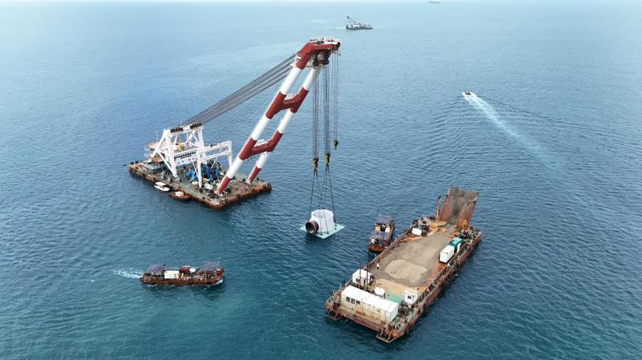
04 Reinforced PE Pipe Connection to the Intake Head
Option 1: Flange Transition (Indirect) Connection — reinforced PE composite pipe can connect to any pipe type, and in turn to the intake head.
Pictured: the intake head is factory-fitted with a short corrosion-resistant steel flange stub, serving as the mating base for the reinforced PE pipe.
Notes:
接下来我们谈谈具体的技术方案。首先是连接问题。PE管和钢结构的取水头怎么连？我们采用非常成熟的钢塑转换法兰连接。简单说，就是在PE管末端焊一个带法兰的接头，然后用螺栓和垫片，像拧瓶盖一样把它和取水头的法兰紧紧连在一起。只要焊接和螺栓紧固到位，这个连接是非常安全可靠的。

Slide 19
04 Reinforced PE Pipe Connection to the Intake Head
Option 2: Custom Integrated Concrete Intake Head, Direct-Connected to Reinforced PE Pipe
*Both options can be custom-engineered for a precise, purpose-built fit.
Option 3: Reinforced PE Pipe with a Custom Spigot/Socket Size, Direct-Connected to the Intake Head
Notes:
接下来我们谈谈具体的技术方案。首先是连接问题。PE管和钢结构的取水头怎么连？我们采用非常成熟的钢塑转换法兰连接。简单说，就是在PE管末端焊一个带法兰的接头，然后用螺栓和垫片，像拧瓶盖一样把它和取水头的法兰紧紧连在一起。只要焊接和螺栓紧固到位，这个连接是非常安全可靠的。

Slide 20
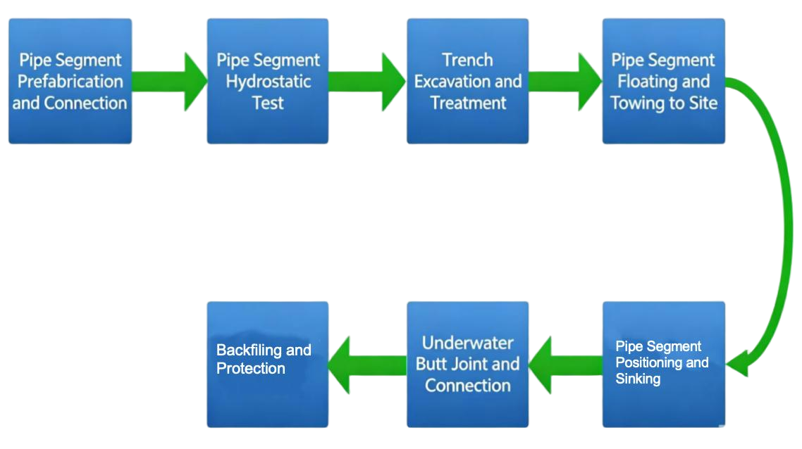
05 Reinforced PE Pipe Installation
Submerged Pipe Installation Method: “Float-and-Sink”
Backfiling and Protection
Pipe Segment Positioning and Sinking
Notes:
施工方面，我们推荐高效的“浮运-沉放”法。简单来说，就是先在岸上把管子焊成几百米长，然后拖到海里，因为PE管比水轻，它会自己浮起来。接着，我们从一头开始往管子里注水，让它慢慢沉下去，形成一个优美的S形曲线。这种方法安全、高效，对海上作业设备要求低，非常适合本项目。

Slide 21
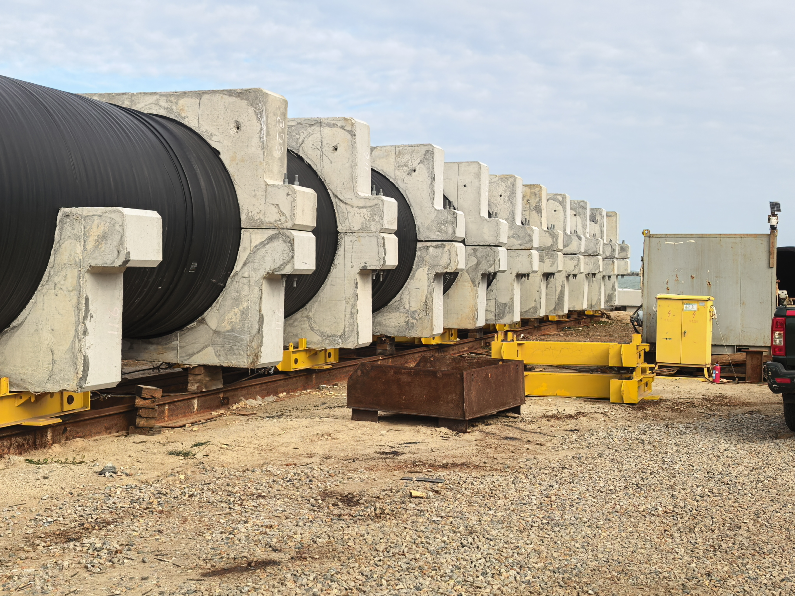
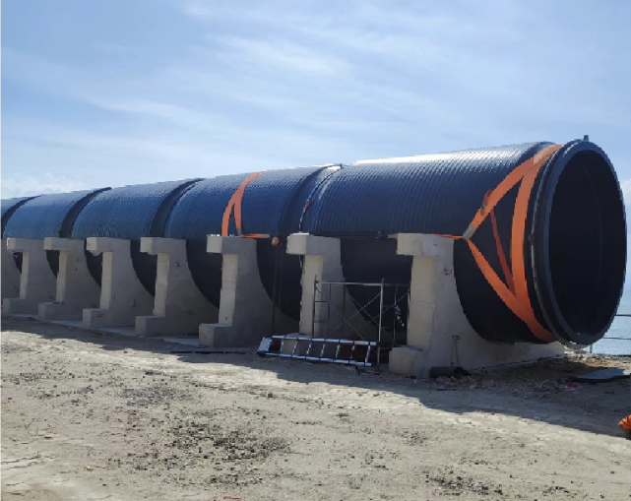
05 Reinforced PE Pipe Installation
Onshore Prefabrication Yard Operations
Large HDPE sections are arranged and welded at a dedicated onshore prefabrication yard, with fittings installed under strict quality control on weld integrity and pipe strength — building a solid structural foundation for subsea sinking operations.
Notes:
这两张图片展示了实际的施工场景。左边是在岸边的预制场，我们在这里把短管子焊成长管段。右边是焊好的超长管段，在浮筒的帮助下，正被拖轮牵引到指定位置准备沉放。整个过程井然有序，高效且安全。

Slide 22
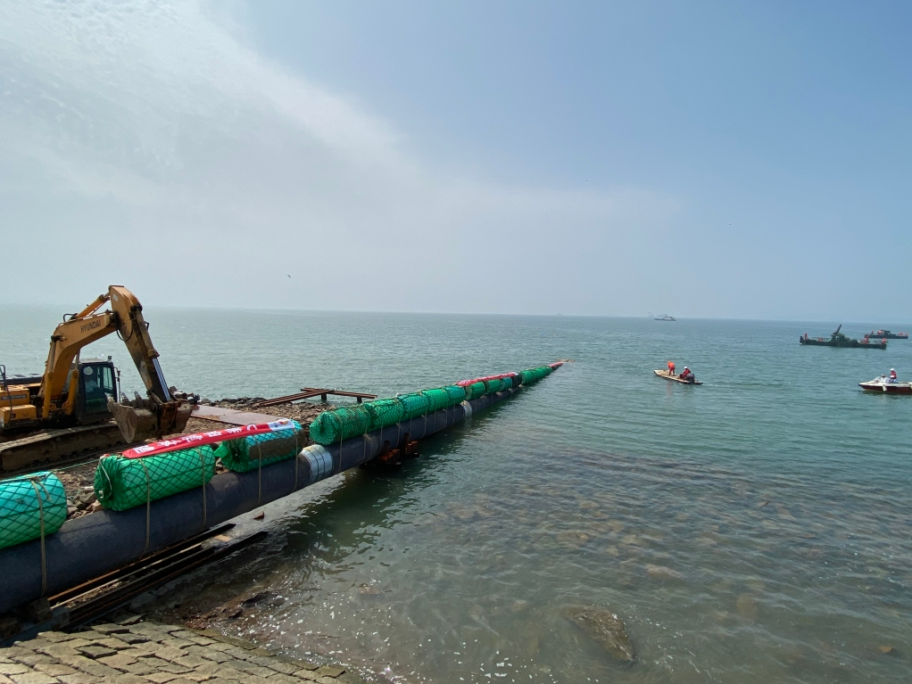
05 Reinforced PE Pipe Installation
Offshore Float-Out & Towing
Notes:
这两张图片展示了实际的施工场景。左边是在岸边的预制场，我们在这里把短管子焊成长管段。右边是焊好的超长管段，在浮筒的帮助下，正被拖轮牵引到指定位置准备沉放。整个过程井然有序，高效且安全。

Slide 23
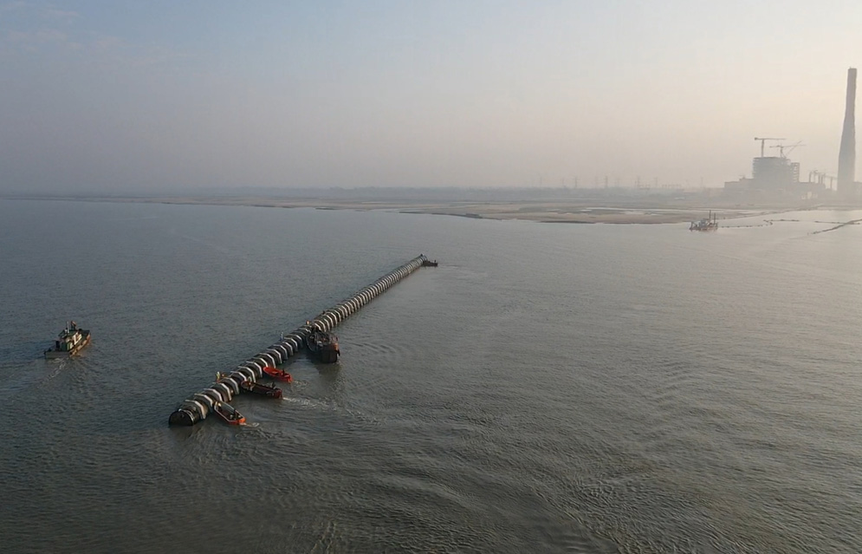
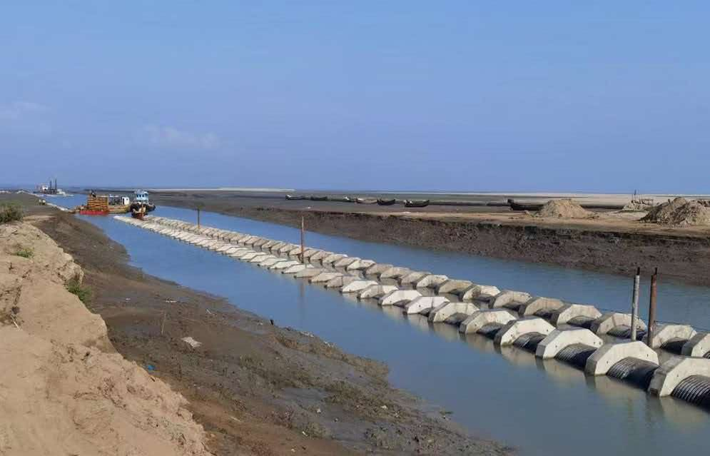
05 Reinforced PE Pipe Installation
Offshore Float-Out & Positioning
Notes:
这两张图片展示了实际的施工场景。左边是在岸边的预制场，我们在这里把短管子焊成长管段。右边是焊好的超长管段，在浮筒的帮助下，正被拖轮牵引到指定位置准备沉放。整个过程井然有序，高效且安全。

Slide 24
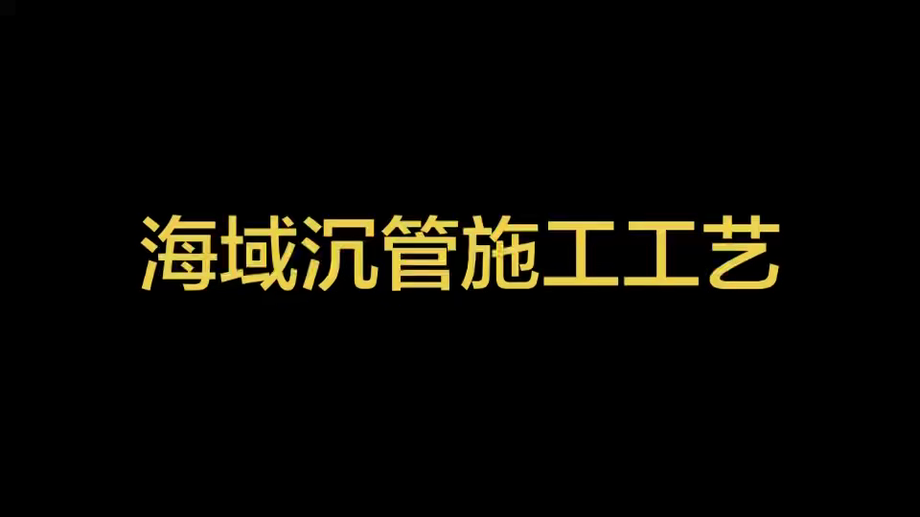
05 Reinforced PE Pipe — Submerged Installation
Notes:
施工方面，我们推荐高效的“浮运-沉放”法。简单来说，就是先在岸上把管子焊成几百米长，然后拖到海里，因为PE管比水轻，它会自己浮起来。接着，我们从一头开始往管子里注水，让它慢慢沉下去，形成一个优美的S形曲线。这种方法安全、高效，对海上作业设备要求低，非常适合本项目。

Slide 25
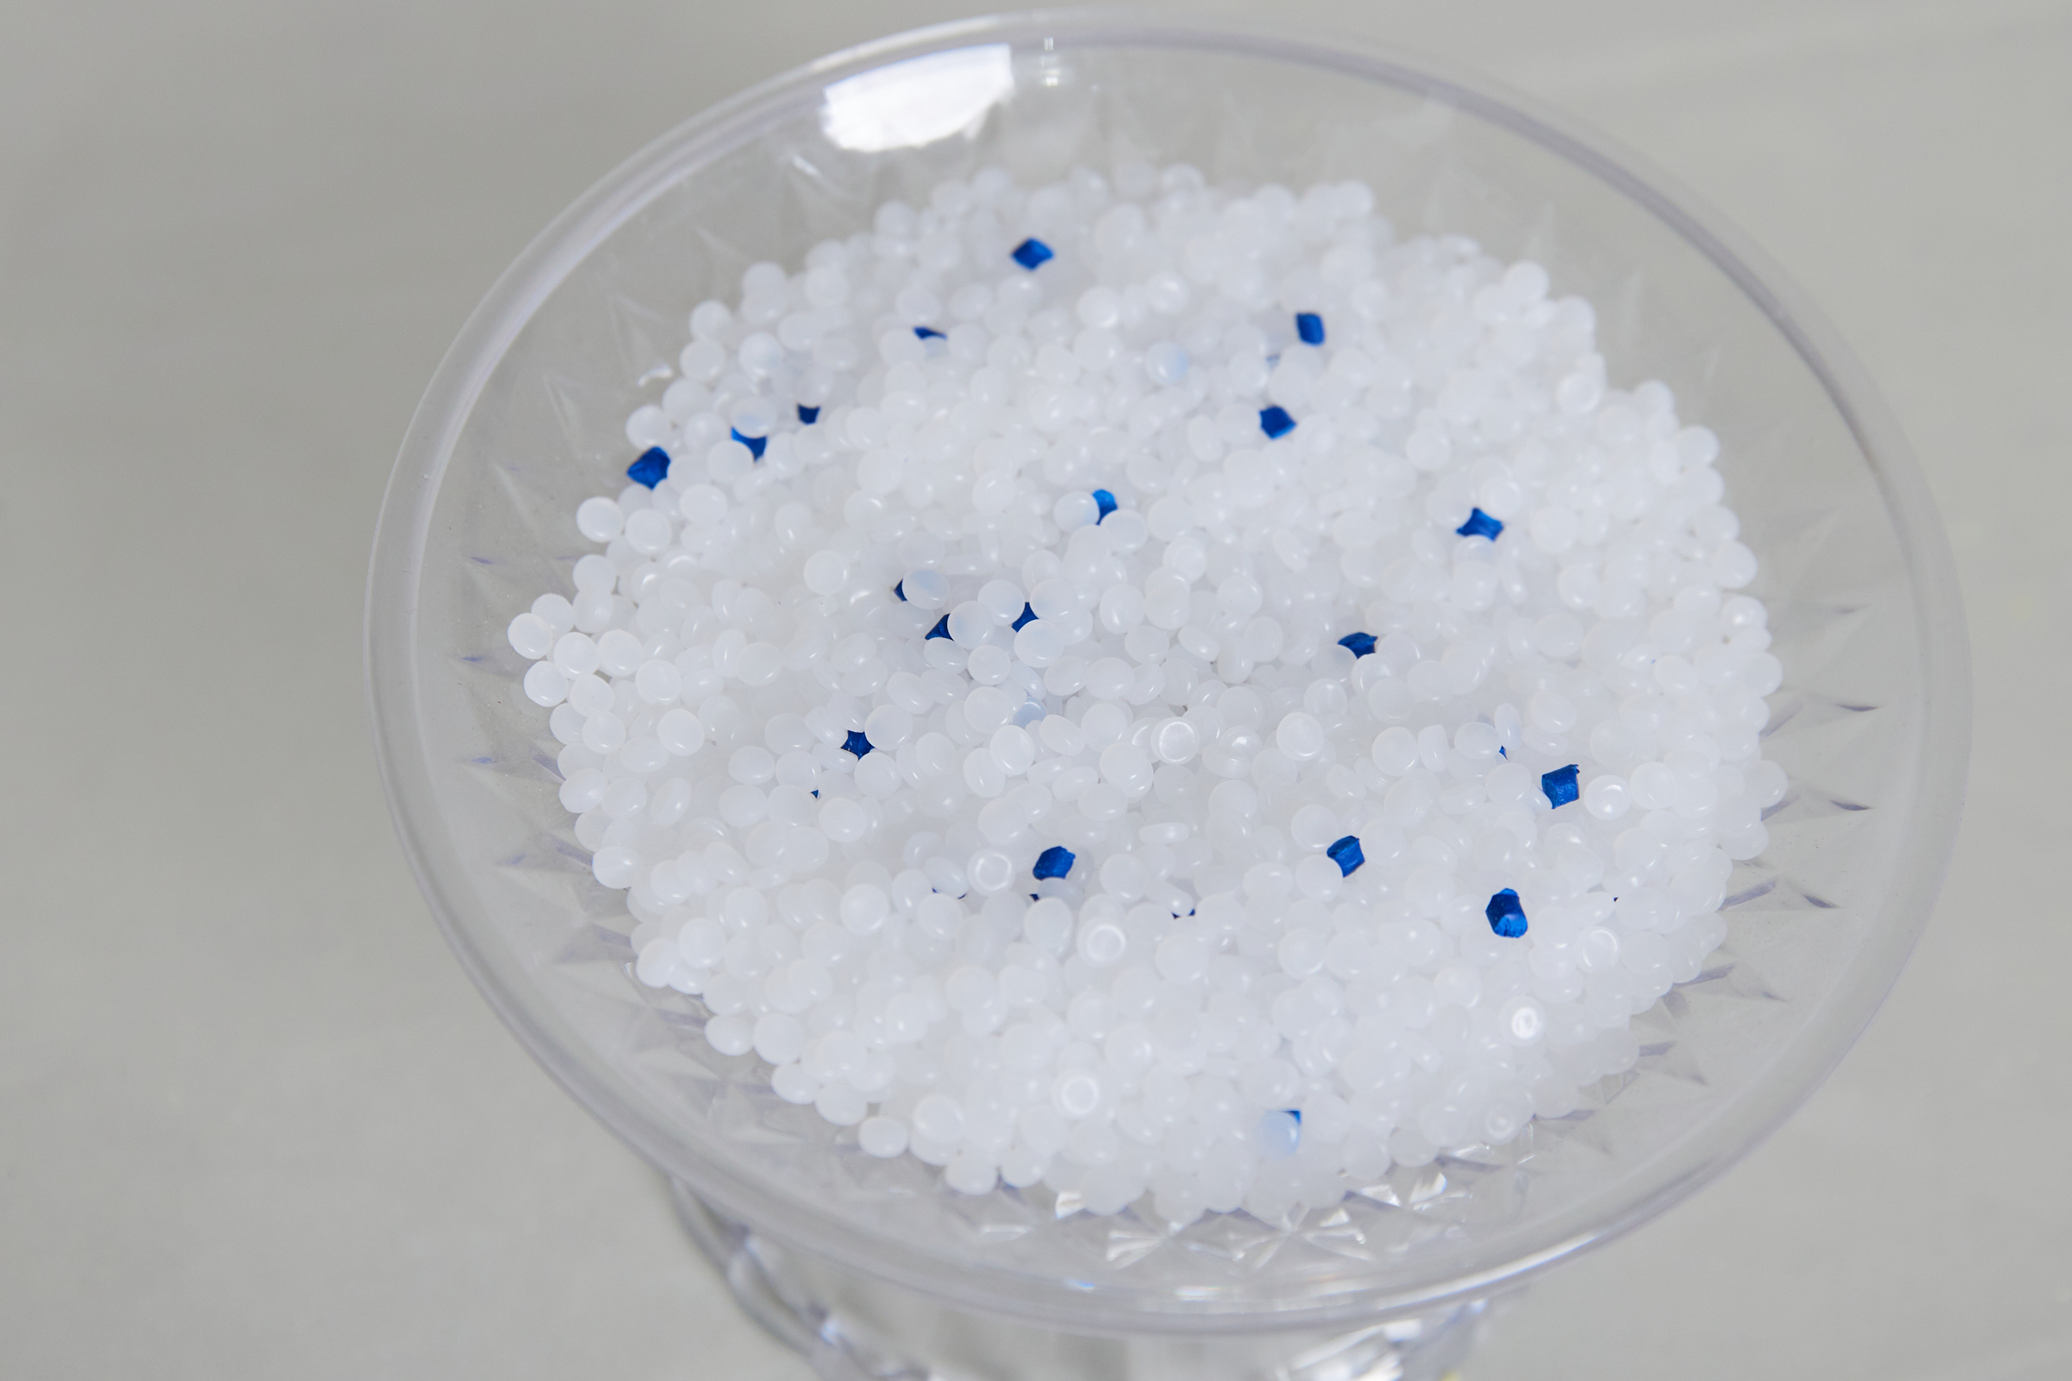
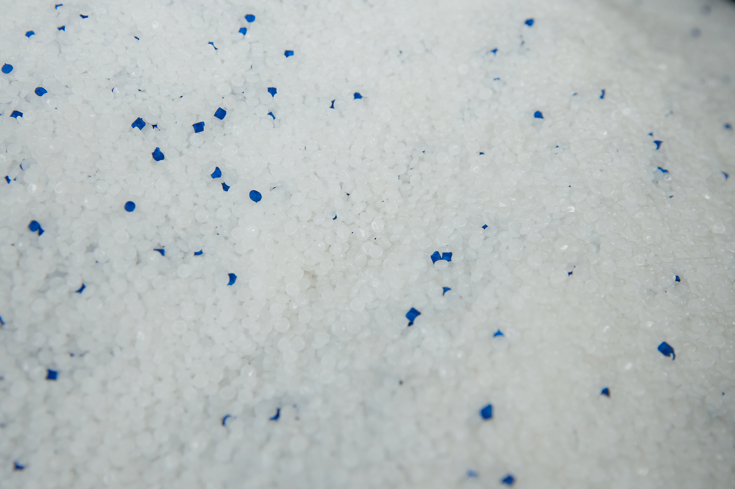
06 Maintenance —Biofouling and Its Impact on Flow Capacity in Seawater Service
I. Reinforced PE Pipe (HDPE)
1. Material Properties:High-molecular-weight PE is chemically inert with low surface energy; the interior wall is extremely smooth and dense, with no pores.
2. Fouling Behavior:Biofouling coverage is far lower than on cement-based materials, and attached organisms bond weakly — partially flushed away at design flow velocity. Large foulers (barnacles, mussels) struggle to establish.
3. Long-Term Impact:
A thin biofilm still forms over time, but it thickens slowly, has minimal effect on flow capacity, and allows long intervals between cleanings.
Notes:
这就是哈夫节的实物图。它就像一个管道的“创可贴”。潜水员在水下将它包裹在破损处，然后用扳手拧紧四周的螺栓，内部的橡胶垫就会被压紧，从而堵住漏洞。这种技术非常成熟，是国际上公认的高效修复手段。

Slide 26
06 Maintenance —Biofouling and Its Impact on Flow Capacity in Seawater Service
II. PCCP Pipe (Prestressed Concrete Cylinder Pipe)
1. Material Properties:The interior surface is cement mortar/concrete — rough, highly porous, with high surface energy and chemical reactivity.
2. Fouling Behavior:The porous, rough surface is an ideal settlement substrate for marine organisms — cement-based material shows the highest biofouling coverage and species diversity of any material tested.
Organisms root into the pores and bond extremely tightly; normal flow can't dislodge them, and mechanical cleaning is difficult and risks damaging the wall.
Biological metabolism also accelerates concrete carbonation and chloride penetration, corroding the internal steel cylinder and prestressing wires — a vicious cycle of “fouling → corrosion → rougher surface → more fouling.”
3. Long-Term Impact:The interior biofouling layer thickens quickly — within 1–2 years it can meaningfully reduce the flow cross-section and increase head loss, with far greater flow-capacity decline than plastic pipe, alongside structural durability risk.
Notes:
这就是哈夫节的实物图。它就像一个管道的“创可贴”。潜水员在水下将它包裹在破损处，然后用扳手拧紧四周的螺栓，内部的橡胶垫就会被压紧，从而堵住漏洞。这种技术非常成熟，是国际上公认的高效修复手段。

Slide 27
07 Repair — Reinforced PE Pipe vs. PCCP Comparison
Reinforced PE pipe offers excellent chemical stability — acid/alkali and corrosion resistant — with a smooth interior that resists scaling and microbial growth, keeping maintenance costs low.
PE pipe repair technology is mature. Split-repair clamps are the industry-standard emergency repair solution, compliant with T/CFA 0205—2025 (Technical Code for Split-Clamp Installation on Pipelines) — simple procedure, high reliability.
For seawater environments, 316L stainless-steel split clamps with seawater-resistant sealing gaskets provide long-term resistance to chloride-induced corrosion.
Comparison | PE Pipe (Split-Clamp Repair) | PCCP Pipe
Underwater Workability | Divers can work directly, no dewatering required | Cracked pipe body can't be repaired underwater; joint leaks require extremely tight tolerances — nearly impossible to fix subsea
Equipment Needed | Basic wrench and sandpaper — no heavy equipment | Requires a crane barge and underwater leveling equipment; large work footprint
Repair Time | 1–2 hours per repair | A single joint repair takes several tidal windows; a cracked section requires cutting and replacement — days of downtime
Repair Cost | Roughly ¥1,000-class per unit; low labor cost | Underwater work plus heavy equipment: 10x+ the cost of a PE repair
Long-Term Reliability | Mechanical seal + corrosion-resistant materials; periodic bolt re-tightening is sufficient | Concrete prone to re-cracking; steel cylinder keeps corroding; high recurrence rate of leaks
Notes:
这就是哈夫节的实物图。它就像一个管道的“创可贴”。潜水员在水下将它包裹在破损处，然后用扳手拧紧四周的螺栓，内部的橡胶垫就会被压紧，从而堵住漏洞。这种技术非常成熟，是国际上公认的高效修复手段。

Slide 28
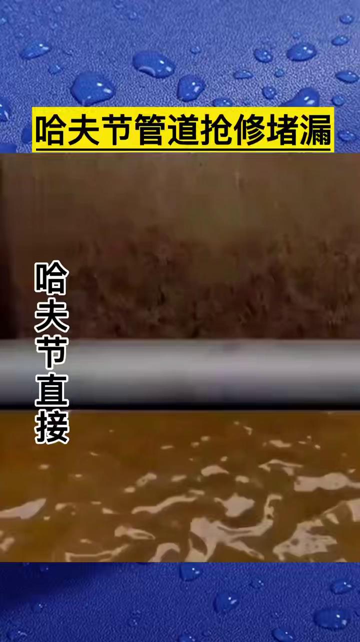
07 Repair —Split-Repair Clamp: Principle & Structure
Definition:Also known as an emergency repair clamp or leak-sealing clamp — a mechanical device for fast, permanent repair of damage on straight pipe sections.
Standard Structure:Two semi-circular shells with a full-circumference seawater-resistant rubber gasket, secured by stainless-steel bolts.
Repair Principle:Bolts clamp the shells tightly around the damaged section; the compressed rubber gasket deforms to form a watertight seal — a permanent repair solution.
*Versus PCCP: PE repair can be performed underwater, needs no heavy equipment, and is fast and low-cost; PCCP cracking/joint leaks are nearly impossible to repair effectively underwater and require full replacement.
Notes:
这就是哈夫节的实物图。它就像一个管道的“创可贴”。潜水员在水下将它包裹在破损处，然后用扳手拧紧四周的螺栓，内部的橡胶垫就会被压紧，从而堵住漏洞。这种技术非常成熟，是国际上公认的高效修复手段。

Slide 29

Thank You
Notes:
我的汇报到此结束，感谢各位的聆听。我们相信，加筋PE管将为印尼这个重要的取水项目保驾护航，开启一个安全、高效、绿色的未来。现在，欢迎大家提问。

